Slide 1





Transform Your Practice with Workshops
Connect, Build Relationships, and Grow Your Business
For more information, email us: team@bambiz.net

Slide 2


Why Host Monthly Workshops
Connect with families in your community
Establish yourself as an expert
Grow your business
For more information, email us: team@bambiz.net
1

Slide 3
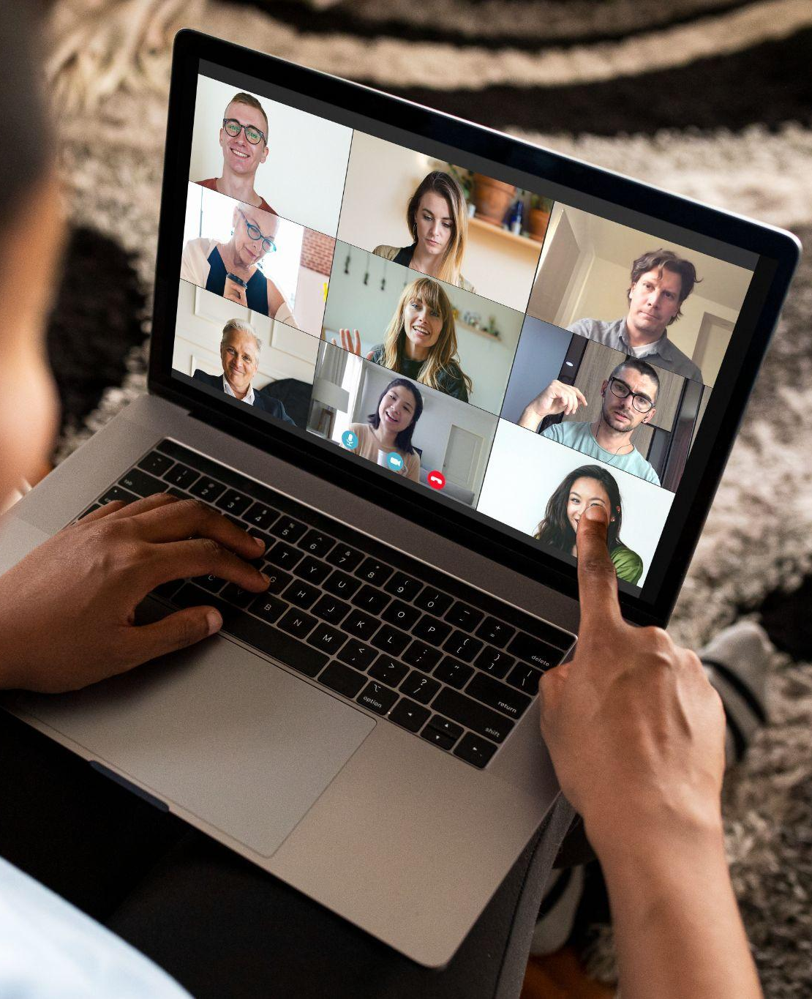
In-Person vs. Virtual Workshops
In-person builds trust and rapport
Virtual offers convenience but less personal connection
For more information, email us: team@bambiz.net
2

Slide 4

Finding the Right Balance
Intimate workshops vs. larger settings
Host workshops 1x/month per location
Create urgency and exclusivity
For more information, email us: team@bambiz.net
3

Slide 5

Maximizing Your ROI
Higher ROI for elder law workshops
Elder law workshops can generate 10x-15x more than estate planning
For more information, email us: team@bambiz.net
4

Slide 6

Choosing the Ideal Venue
Affordable and convenient location
Focus on content, not refreshments
For more information, email us: team@bambiz.net
5

Slide 7

Structuring Your Workshop
Duration: 45 minutes to 1 hour + 15 minutes for Q&A
Start with a relatable story
Valuable insights and next steps
Scheduling consultations
Building and maintaining relationships
For more information, email us: team@bambiz.net
6

Slide 8

Leveraging Partnerships
Collaborate with your community
  Ex: financial planners, geriatric care managers, accountants
Enhance workshop value
For more information, email us: team@bambiz.net
7

Slide 9

Using a Robust Marketing Strategy
Use social media, email marketing, targeted ads
Use testimonials for credibility
Create urgency with limited seating
For more information, email us: team@bambiz.net
8
8

Slide 10
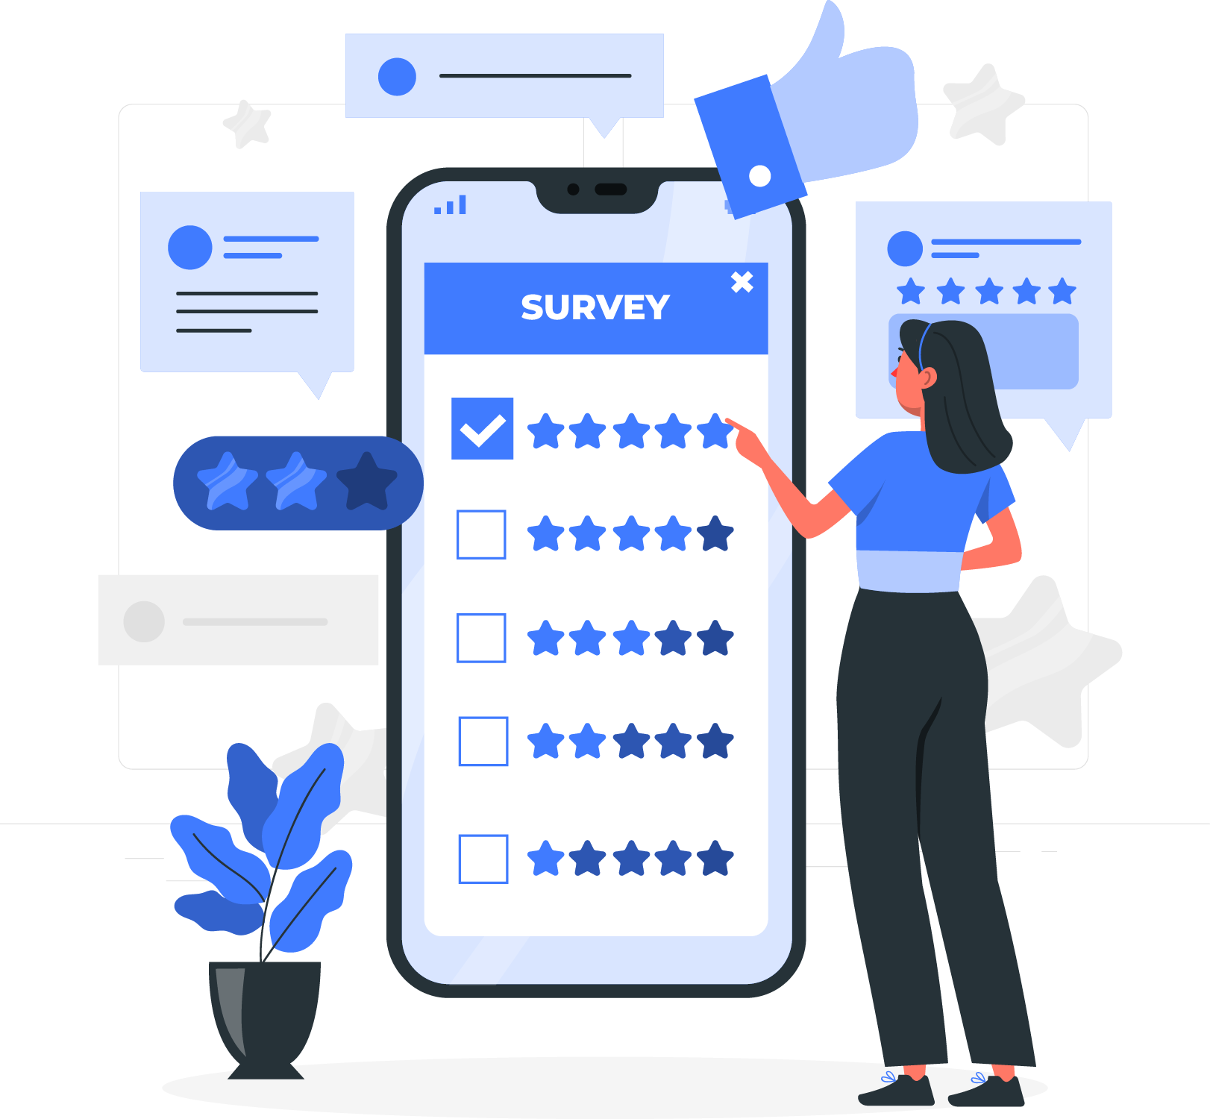
Gathering Feedback
Use post-event surveys
Identify areas for improvement
For more information, email us: team@bambiz.net
9

Slide 11

Tracking Workshop Success
Measure
  # of attendees
  engagement levels
  conversion rates
Fine-tune strategies for effectiveness
For more information, email us: team@bambiz.net
10

Slide 12
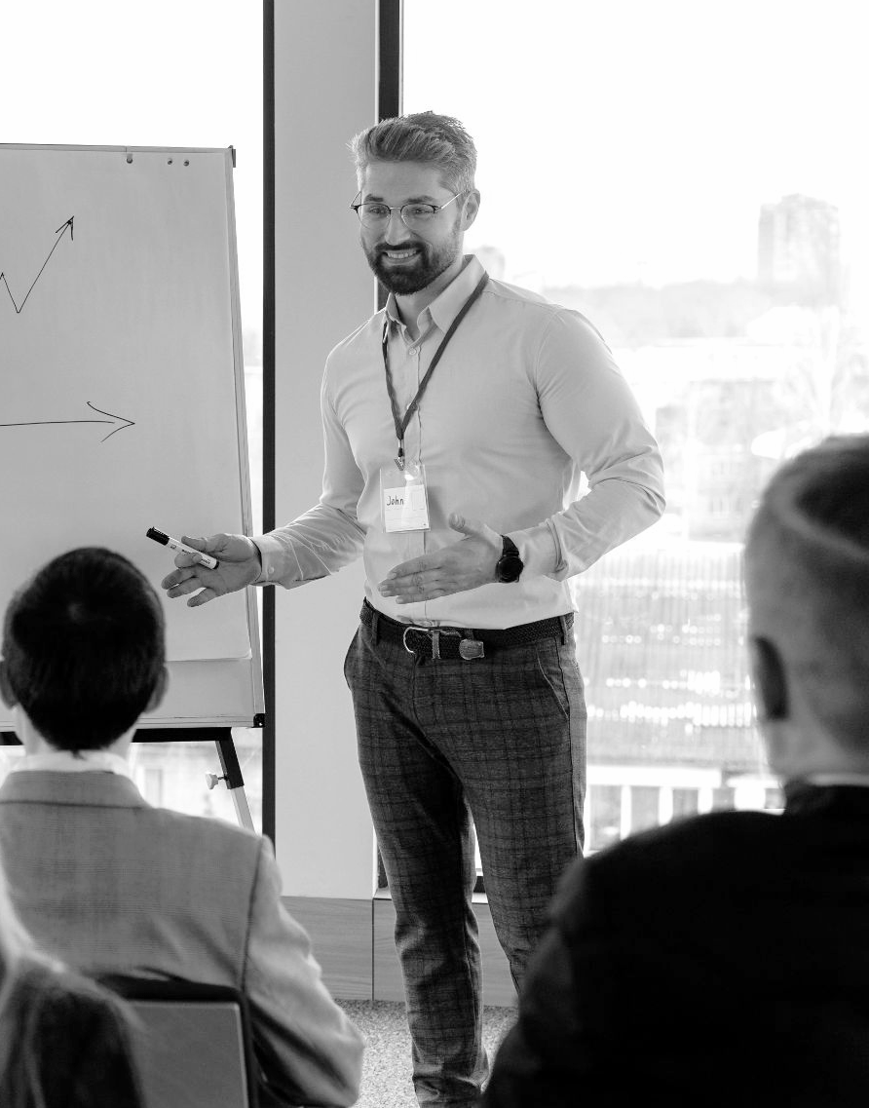

Venue Selection Criteria
Size,
Accessibility,
Ambiance,
Cost
For more information, email us: team@bambiz.net
11

Slide 13
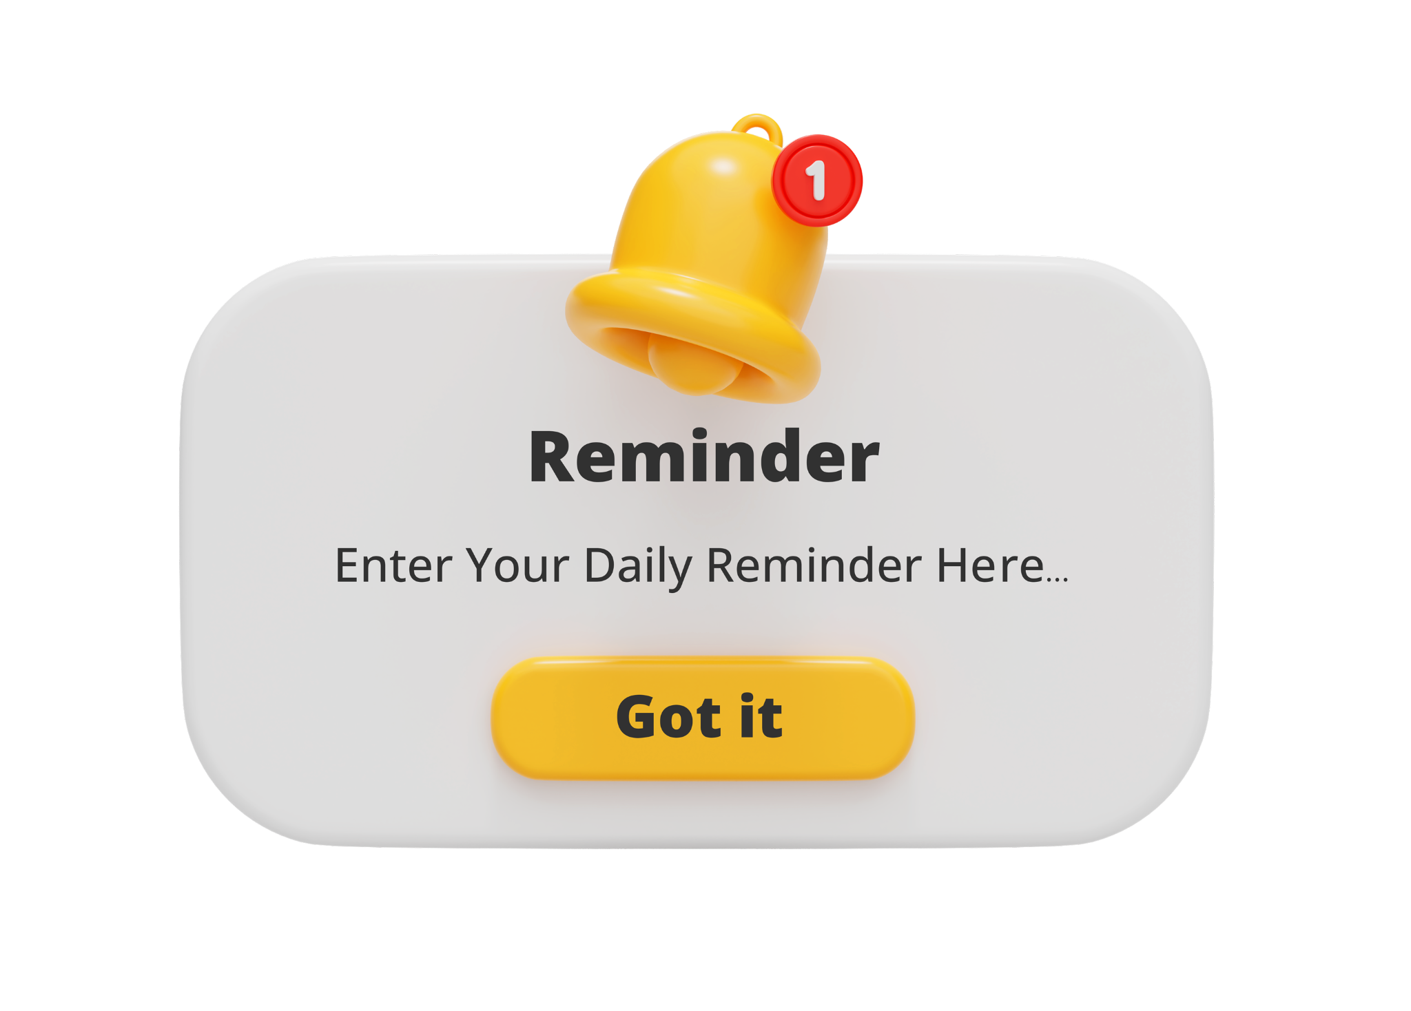
Ensuring High Turnout
Send reminder emails and texts
Encourage attendees to bring friends/family
Offer incentives like free resources or consultations
For more information, email us: team@bambiz.net
12

Slide 14
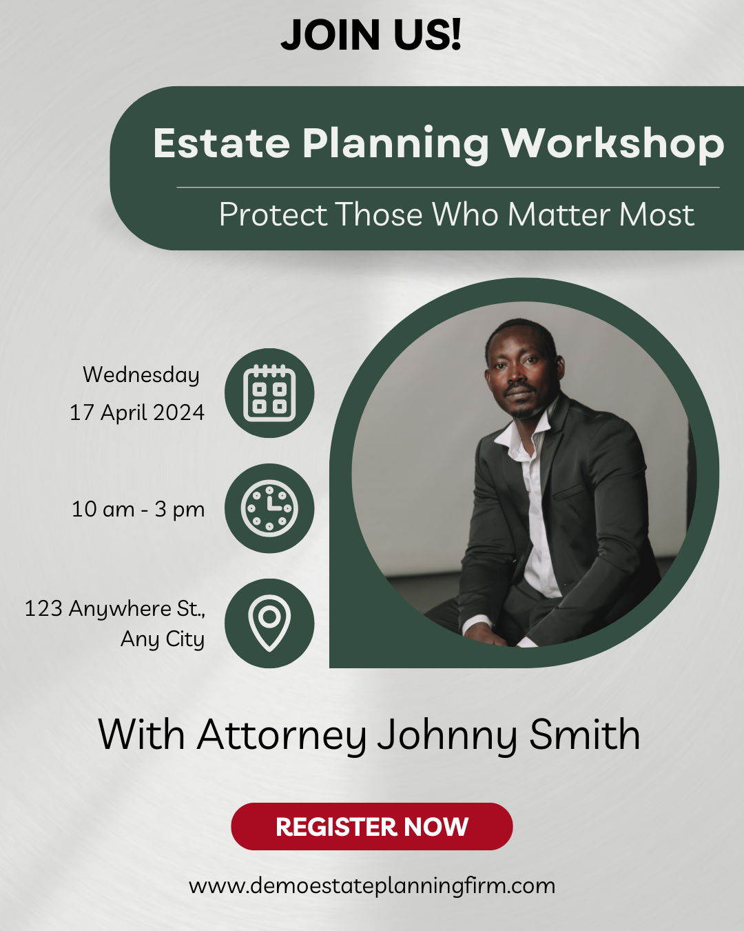
Creating High-Performing Ad Campaigns
Monitor:
  Cost Per Lead (CPL)
  Conversion Rate
Split-test ad copy and landing page
For more information, email us: team@bambiz.net
13

Slide 15
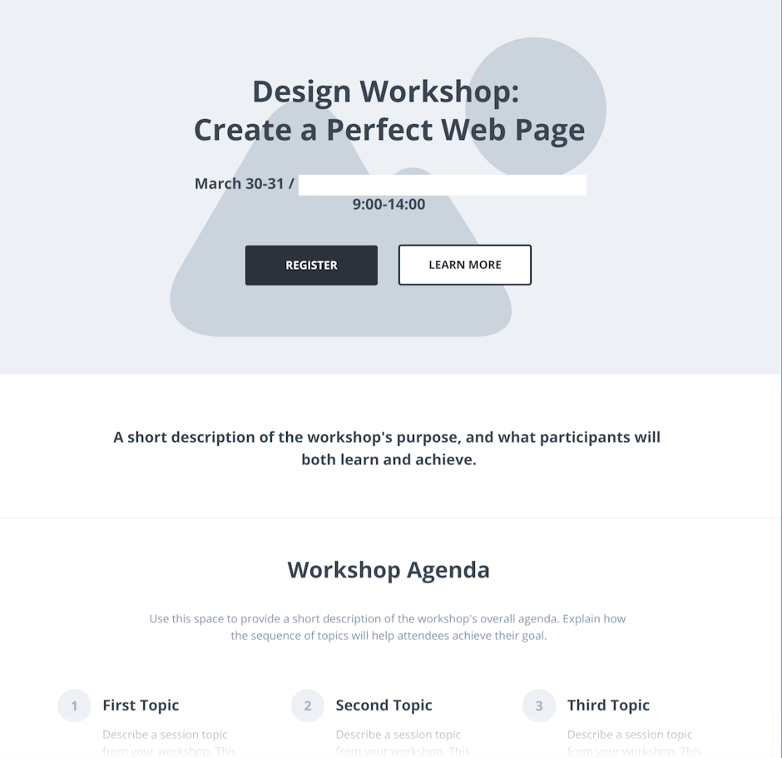
Designing an Effective Landing Page
Clear, compelling headline
Concise copy with main takeaways and incentives
High-quality visuals and easy registration form
For more information, email us: team@bambiz.net
14

Slide 16
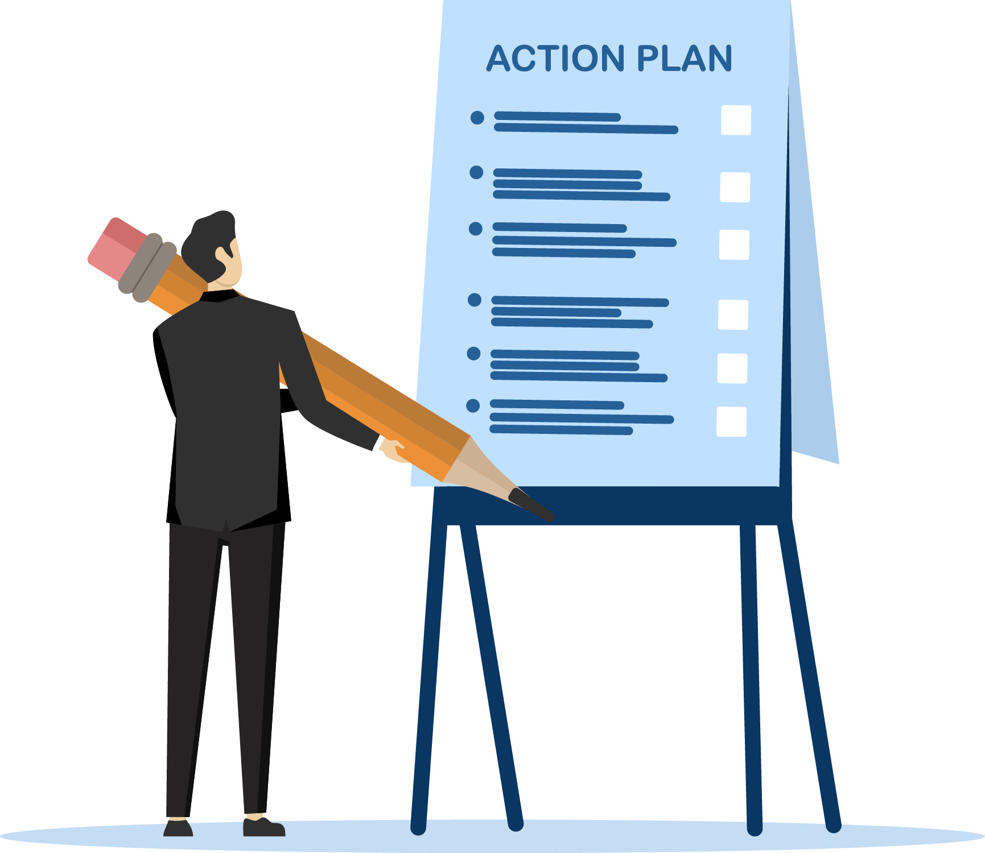
Time to Take Action
Develop a 30-50 minute presentation with Q&A
Find an affordable venue for 20-30 attendees
Prepare 3-4 weeks in advance
Promote the event online 2 weeks before the date
Follow-up with attendees before the event
For more information, email us: team@bambiz.net
15

Slide 17
Let’s Recap
Recap: Transform Your Practice with Workshops
Continuous improvement
Next video topic: Webinars
For more information, email us: team@bambiz.net
12

