Slide 1




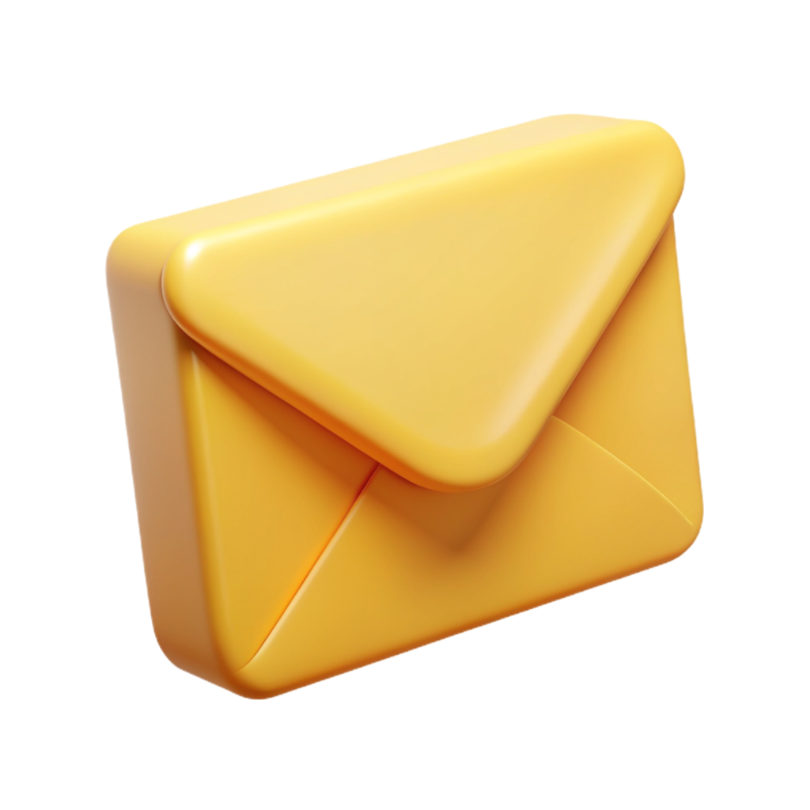
Email Management Strategies for Law Firms
For more information, email us: team@bambiz.net

Slide 2
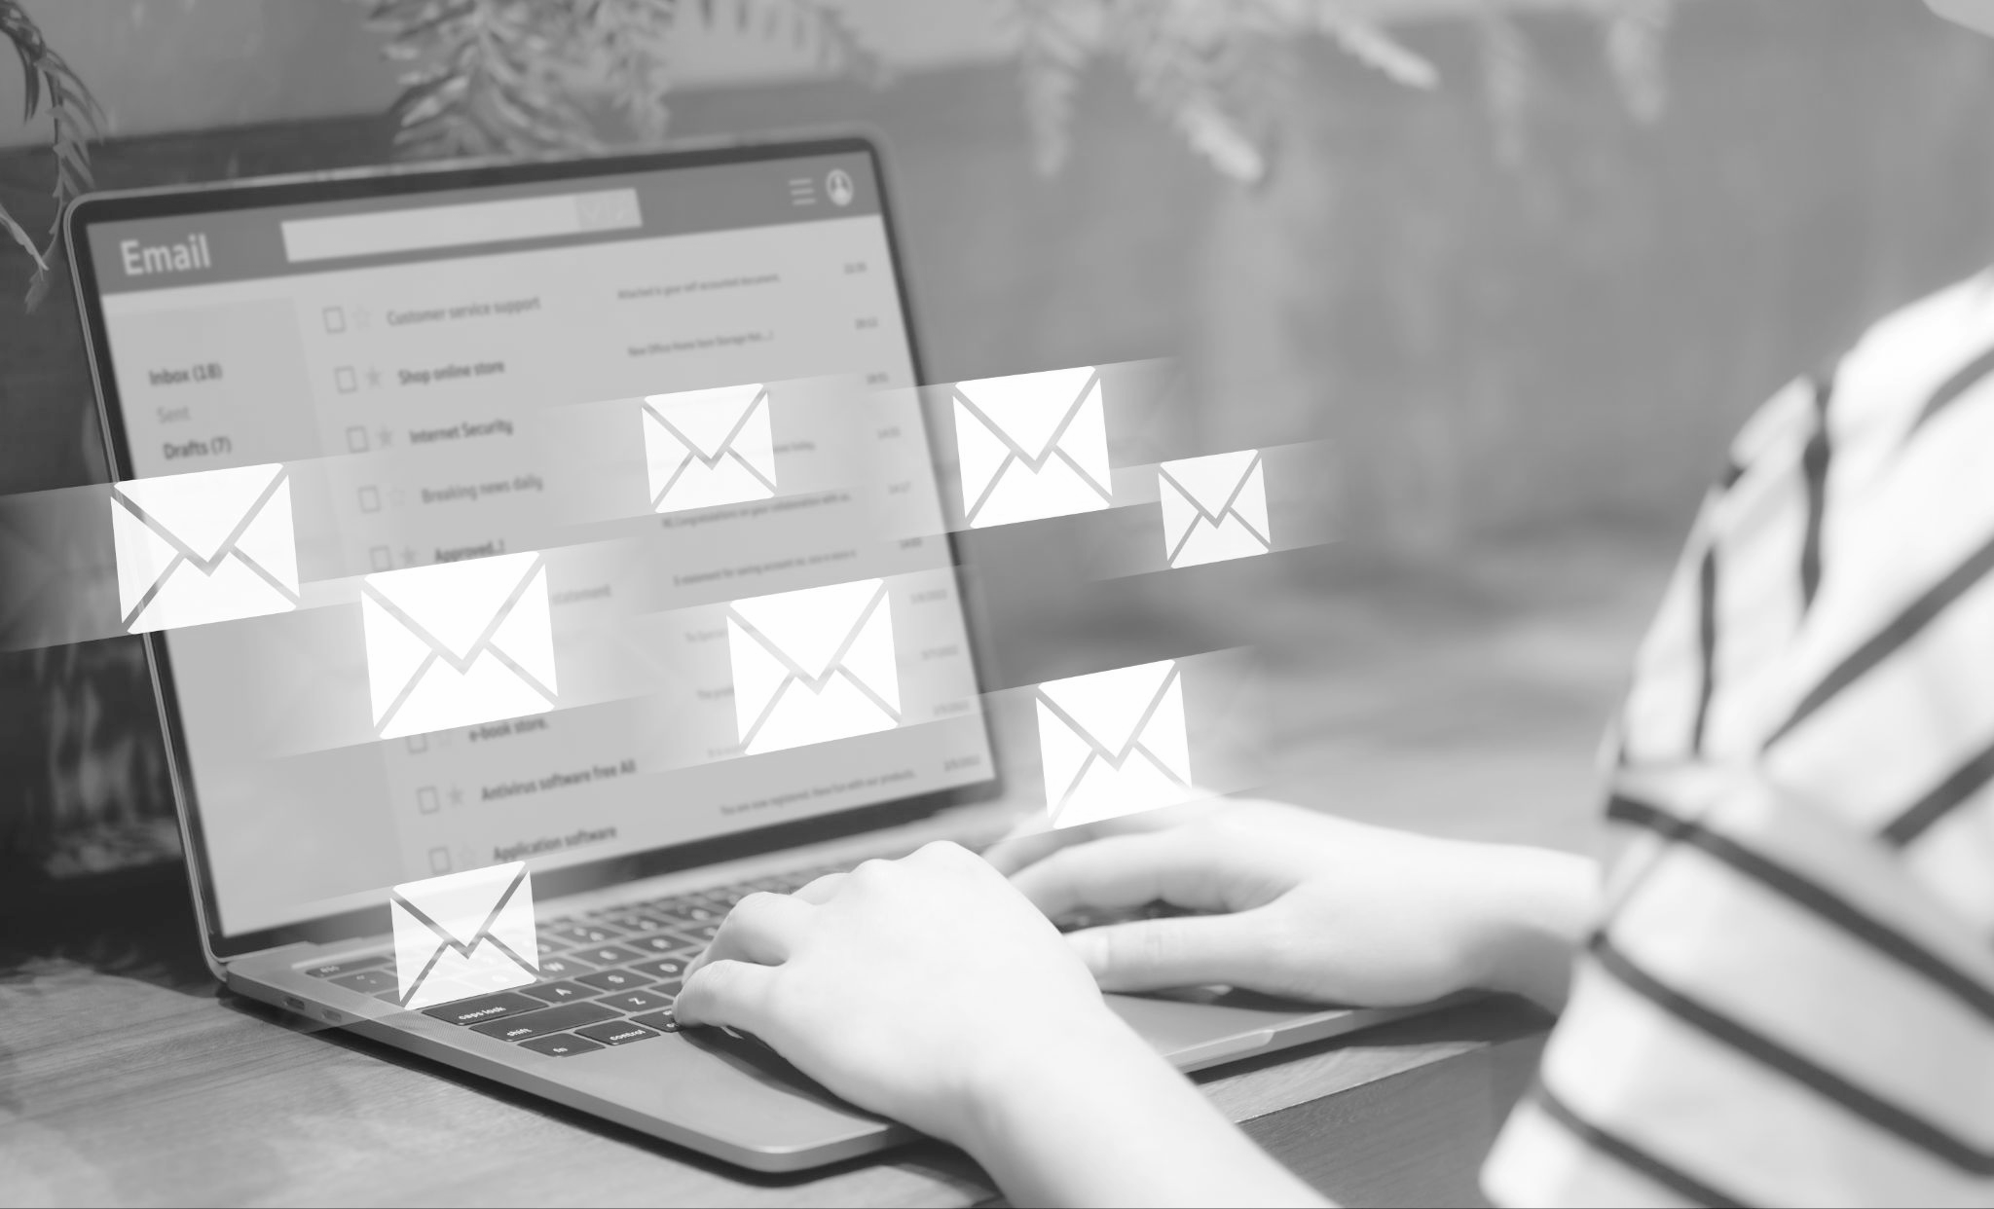

The Power of Email Marketing
Direct connection with audience
Nurture leads and build relationships
Stay top-of-mind and grow your practice
For more information, email us: team@bambiz.net
1

Slide 3

Weekly Email Newsletters
Importance of consistency
Provide valuable content
Keep audience engaged
For more information, email us: team@bambiz.net
2

Slide 4
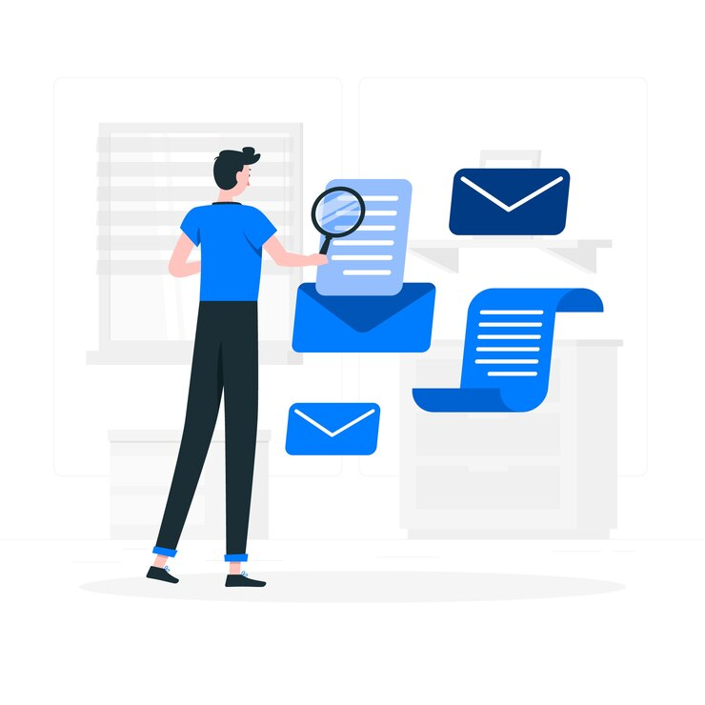
What Goes into a Winning Newsletter?
Relevant articles on elder law and estate planning
Upcoming workshops and events
Client testimonials and case studies
Personal messages from attorneys
Clear CTAs
For more information, email us: team@bambiz.net
3

Slide 5
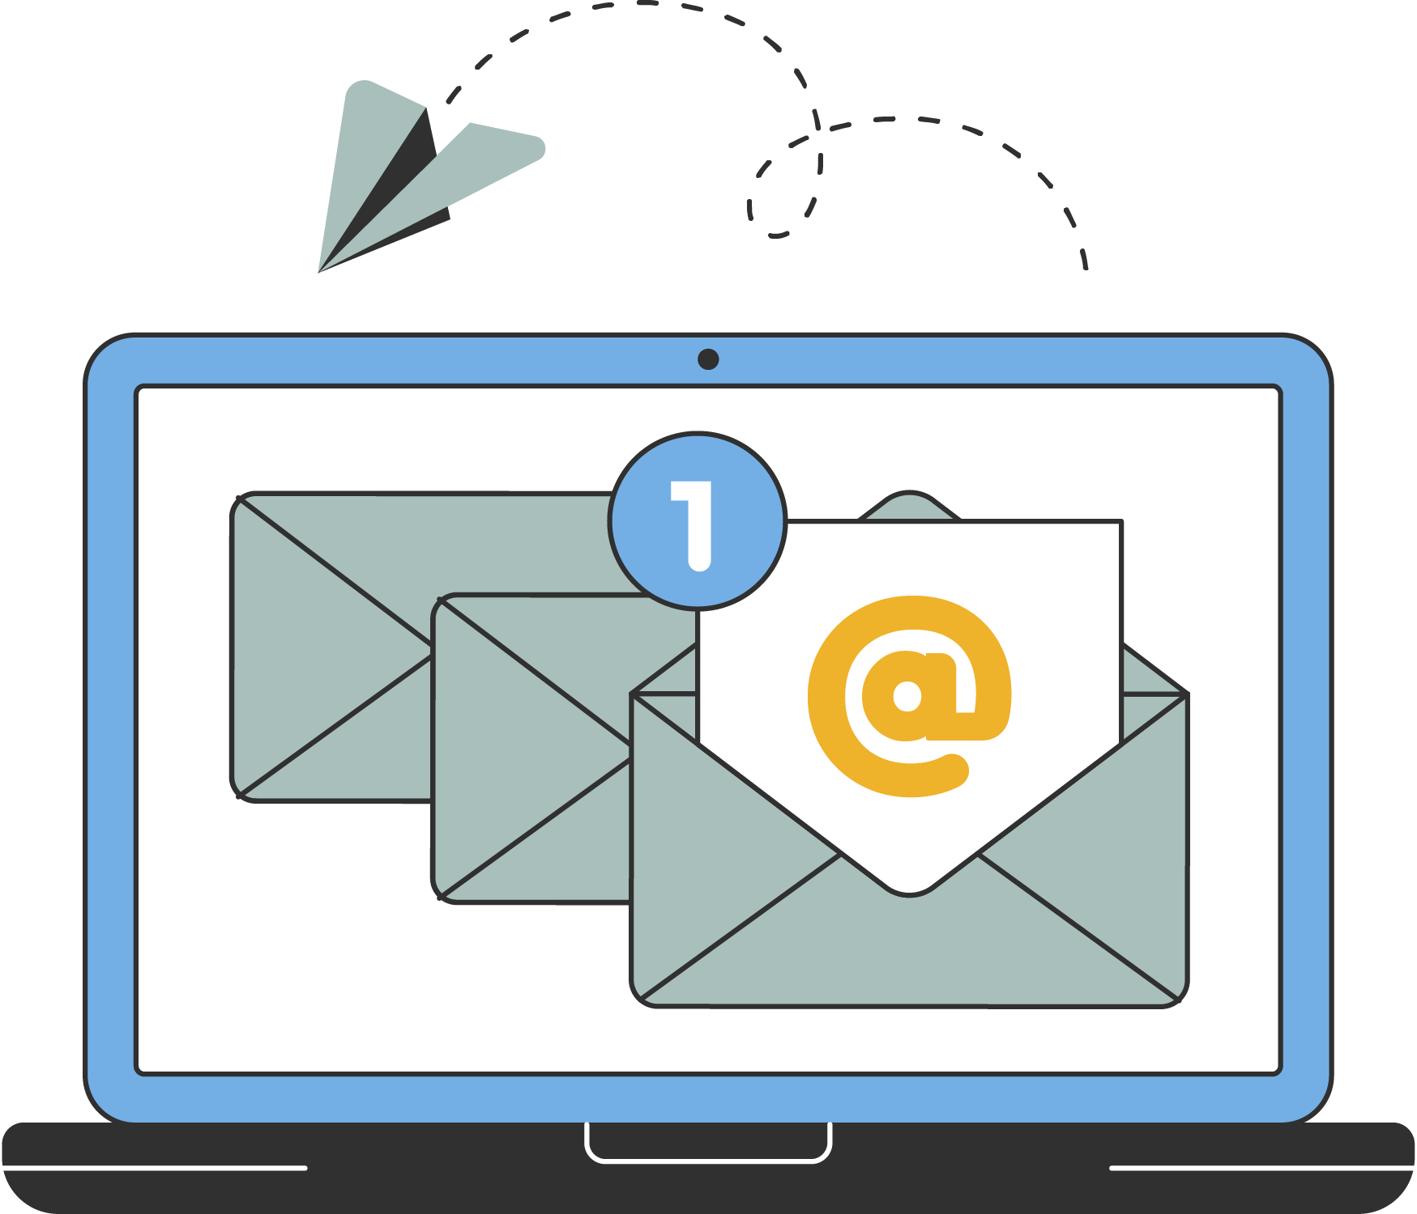
Drip Email Sequences
Automated emails to nurture leads
Personal and educational content
Encourages conversion
For more information, email us: team@bambiz.net
4

Slide 6
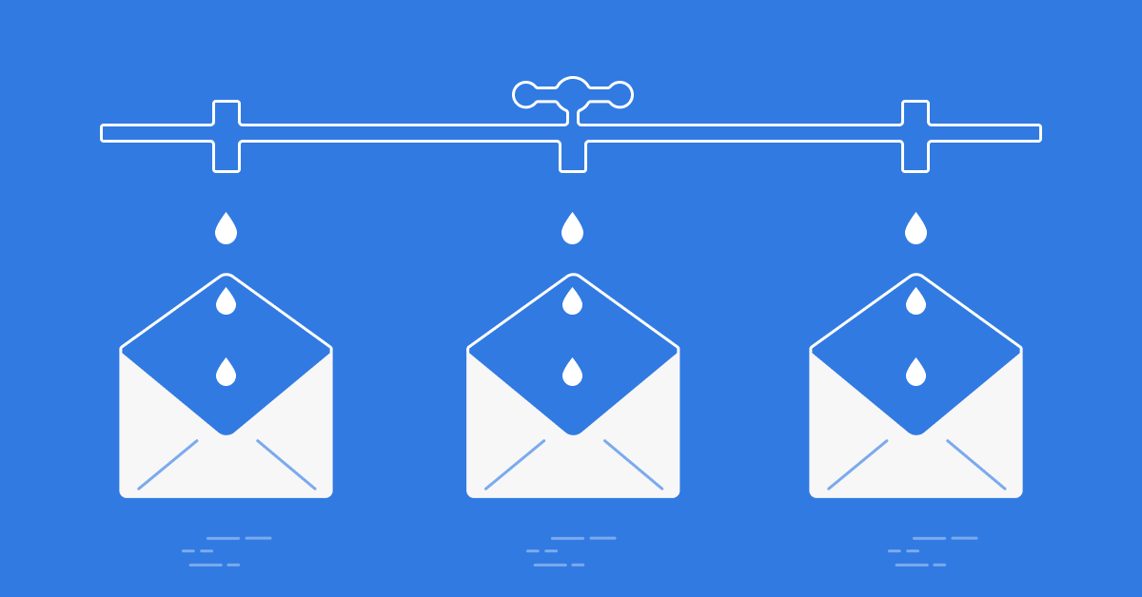
How to Build an Effective Drip Sequence
Five emails over a week
Topics: Introduction, firm motivation, service benefits, industry news, CTA
Personal tone
For more information, email us: team@bambiz.net
5

Slide 7
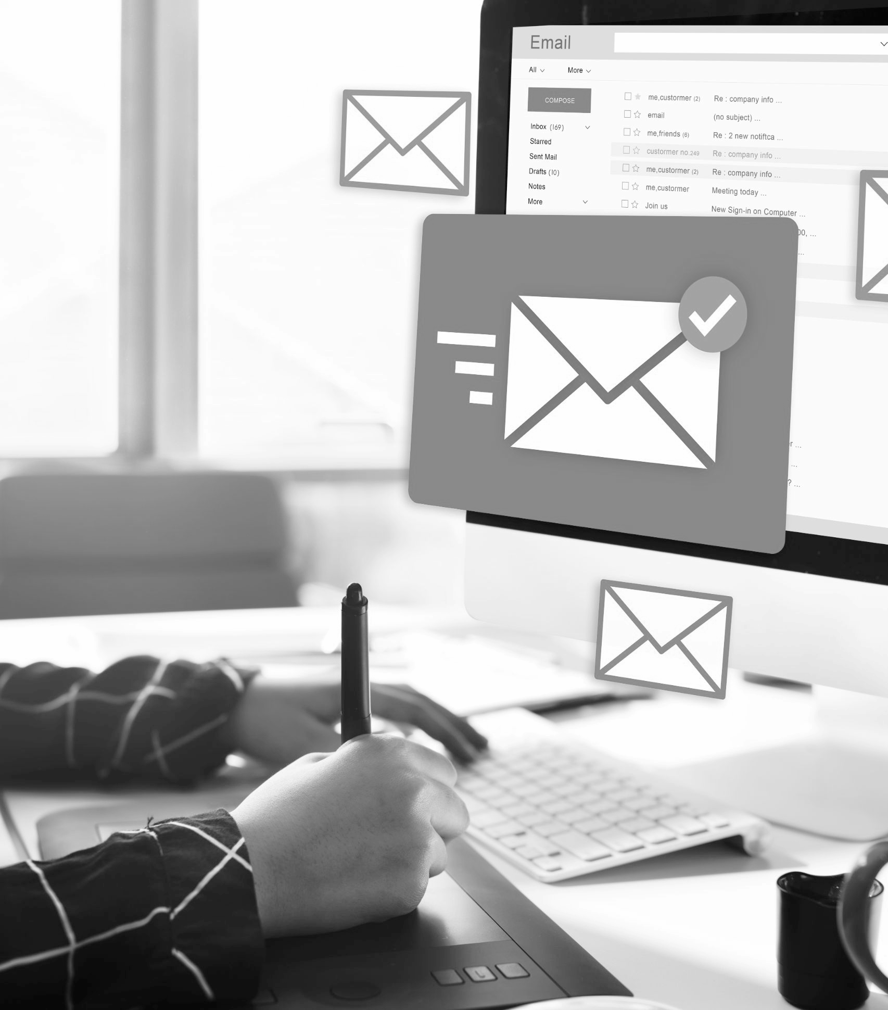
Why Email Lists are Important
Direct communication with clients and prospects
Control over content delivery
Ability to segment for customized messaging
For more information, email us: team@bambiz.net
7

Slide 8
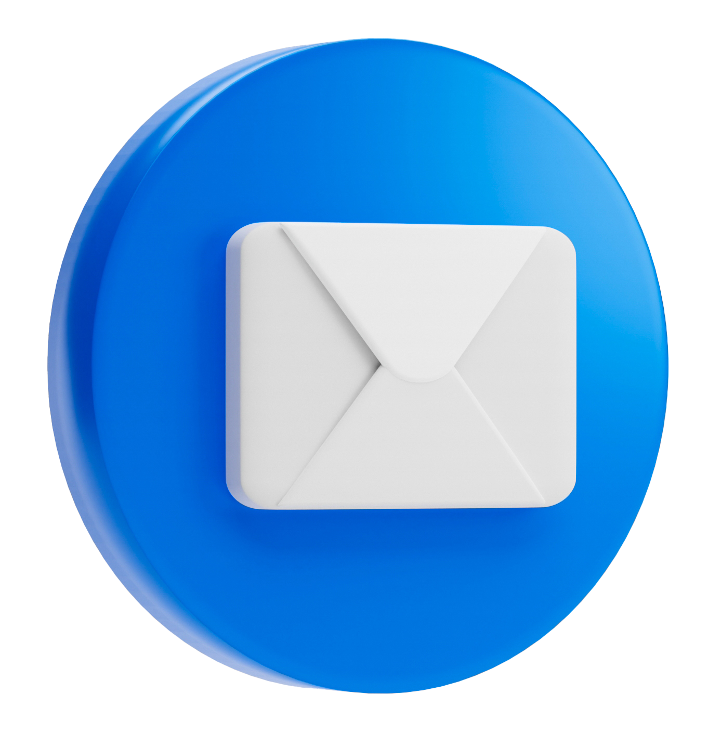
Maintaining a Healthy Email List
Regularly clean your list
Monitor key metrics
Test different subject lines and formats
Encourage engagement with interactive elements
For more information, email us: team@bambiz.net
8

Slide 9

Ensuring Legal Compliance
Get explicit permission from recipients
Include clear unsubscribe link
Provide physical address in email footer
Avoid misleading information
For more information, email us: team@bambiz.net
9

Slide 10
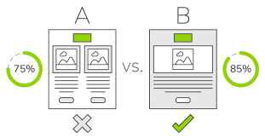
A/B Testing for Emails
Compare different email elements
Test subject lines and CTAs
Maximize engagement and conversions
For more information, email us: team@bambiz.net
10

Slide 11
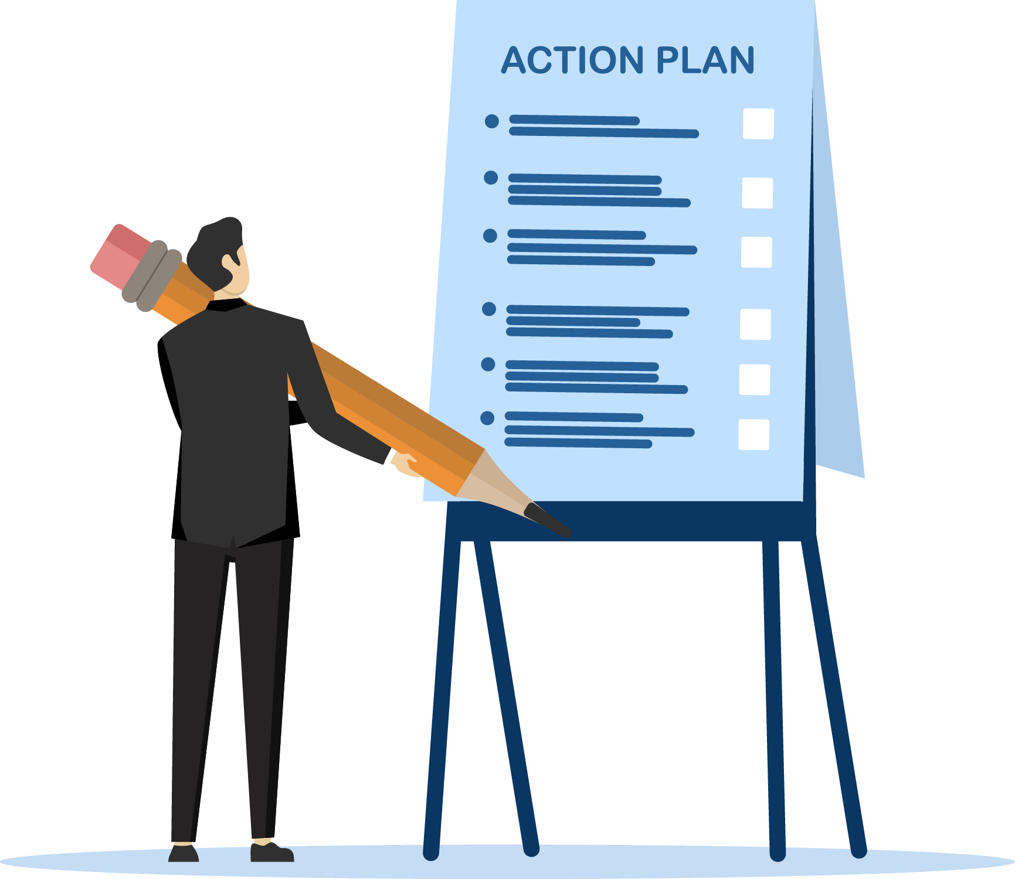
Action Steps
Compile and add contacts to an email management system
Design a newsletter template
Craft brief, educational content for newsletters
Schedule newsletters consistently
Write a series of five personal drip emails
Distribute drip sequence to new subscribers
For more information, email us: team@bambiz.net
17

Slide 12
Let’s Recap
Stay consistent with email marketing
Refine your approach based on results
Investment in long-term success
Next video: Transform Your Practice with Workshops
For more information, email us: team@bambiz.net
12

