Slide 1





Social Media and YouTube Marketing for Elder Law & Estate Planning Firms
Build Your Online Presence and Connect with Clients
For more information, email us: team@bambiz.net

Slide 2


Mastering Social Media Platforms
Know the Platforms
Target Audience
Content Strategy
Consistency is Key
Engage with Your Audience
Track and Analyze
For more information, email us: team@bambiz.net
1

Slide 3

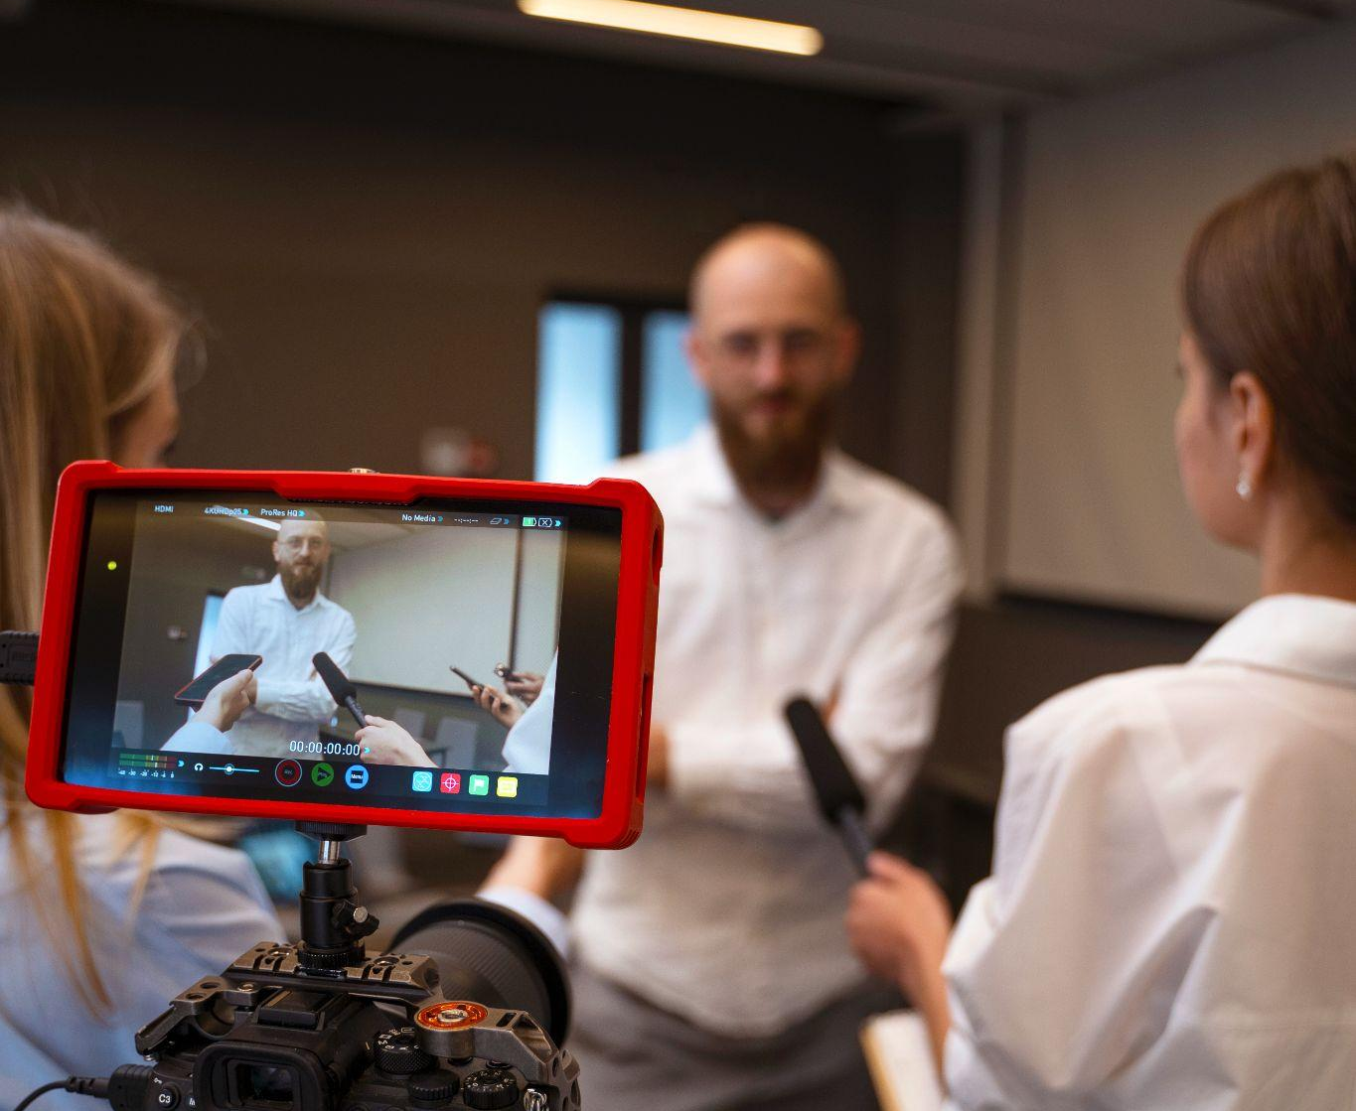
Balancing Client and Personal Content
Showcase client work and the human side of the firm
Build connection and trust
For more information, email us: team@bambiz.net
2

Slide 4


Consistency is Key
Post 2-3 times a week
Stick to a schedule
Use social media scheduling tools or outsource
For more information, email us: team@bambiz.net
3

Slide 5

Create a Content Calendar
Plan and organize consistent content
Determine posting frequency and content themes
Monitor and adjust based on performance
For more information, email us: team@bambiz.net
4

Slide 6

Types of Social Media Content
Informative posts
Engaging questions
Case studies (with permission)
Fun and light-hearted posts
For more information, email us: team@bambiz.net
5

Slide 7

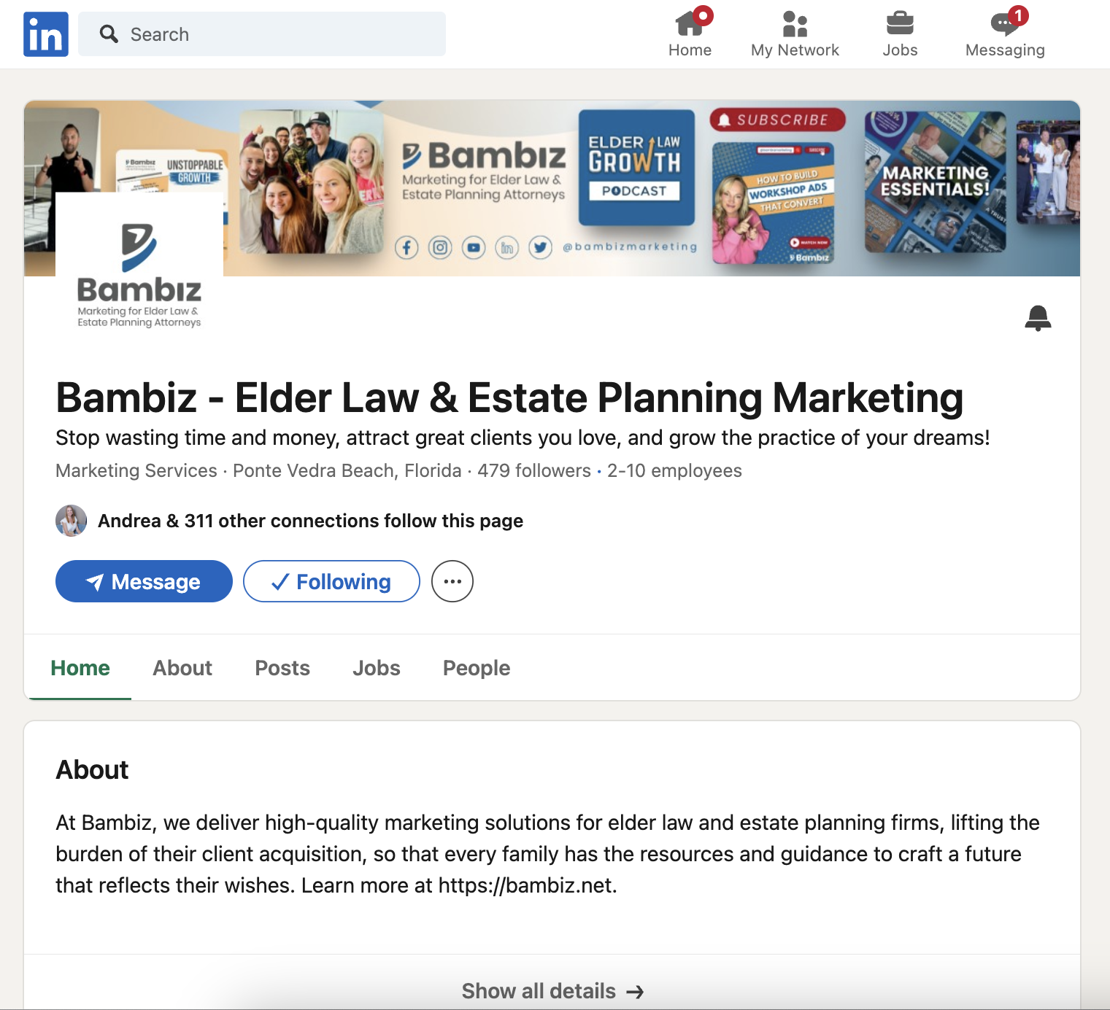
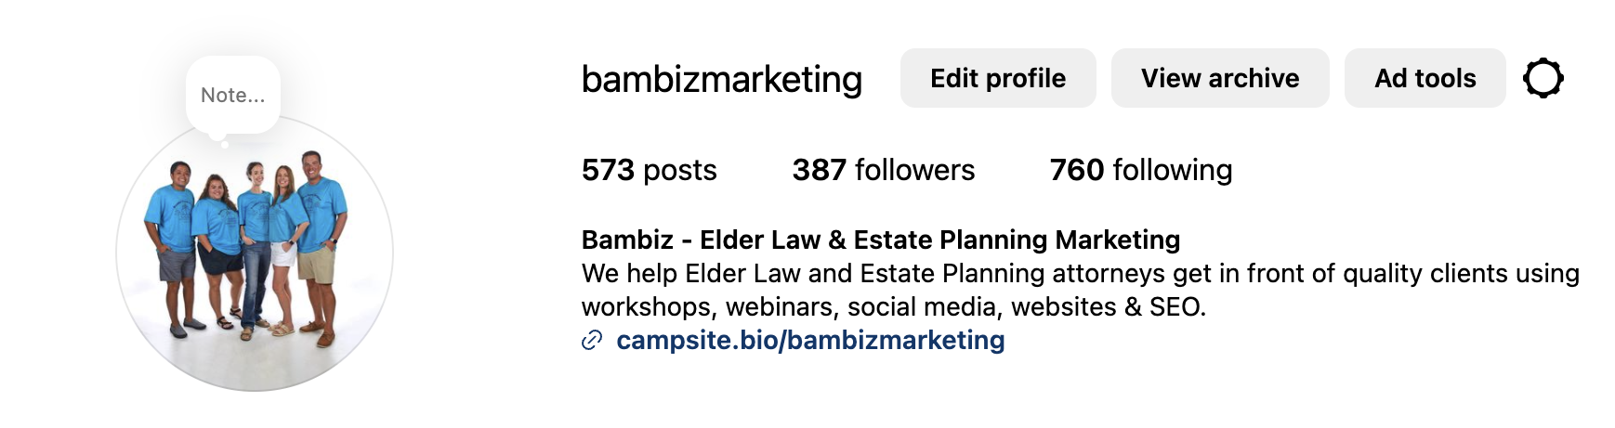
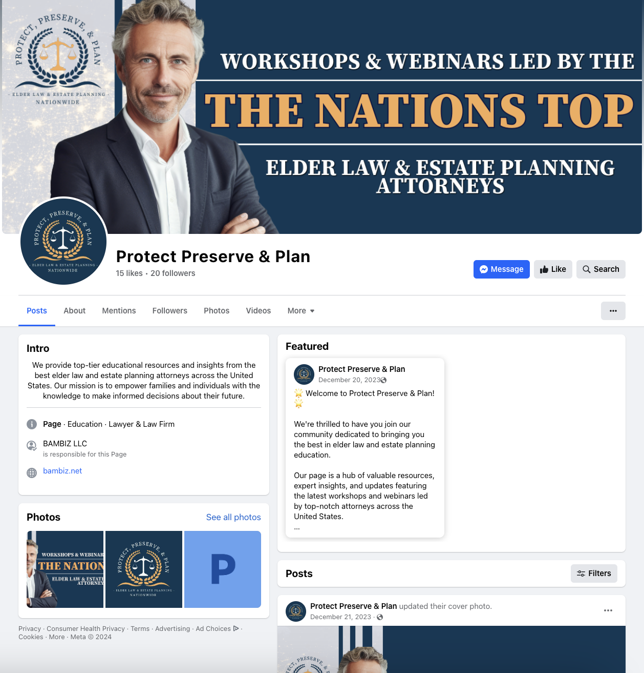
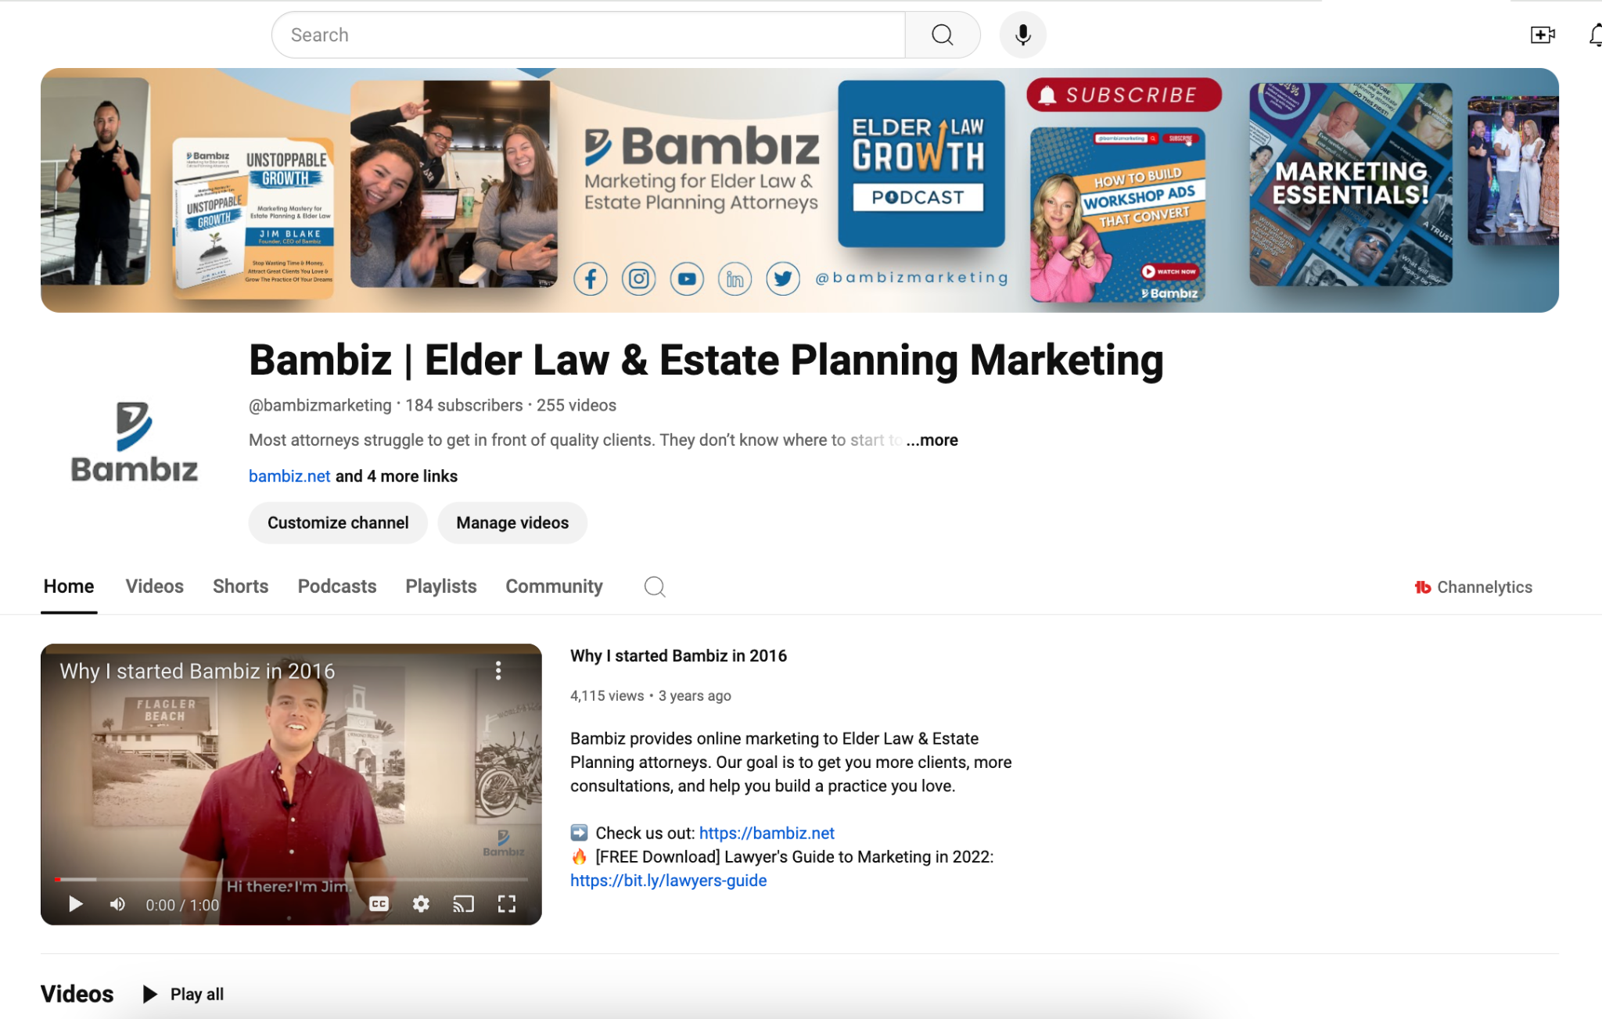
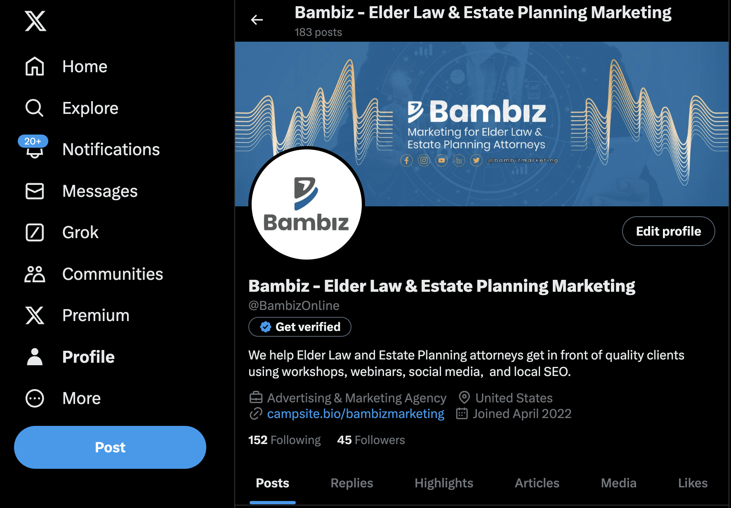
Platform Strategy
For more information, email us: team@bambiz.net
6

Slide 8
LinkedIn
Build connections, share articles and industry news
Participate in relevant groups and discussions
Optimize profile with professional photo and keyword-rich headline
For more information, email us: team@bambiz.net
7

Slide 9
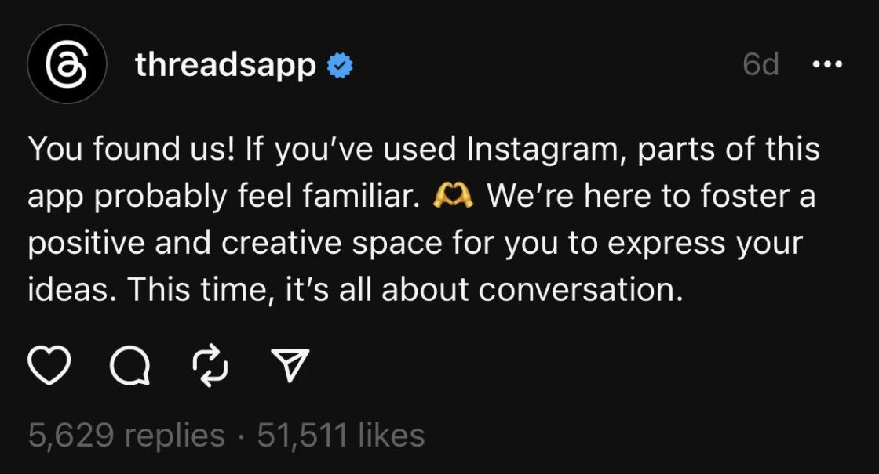
X, Twitter, and Instagram Threads
Share quick updates, tips, and articles
Use relevant hashtags
Engage with followers through retweets and replies
For more information, email us: team@bambiz.net
8

Slide 10
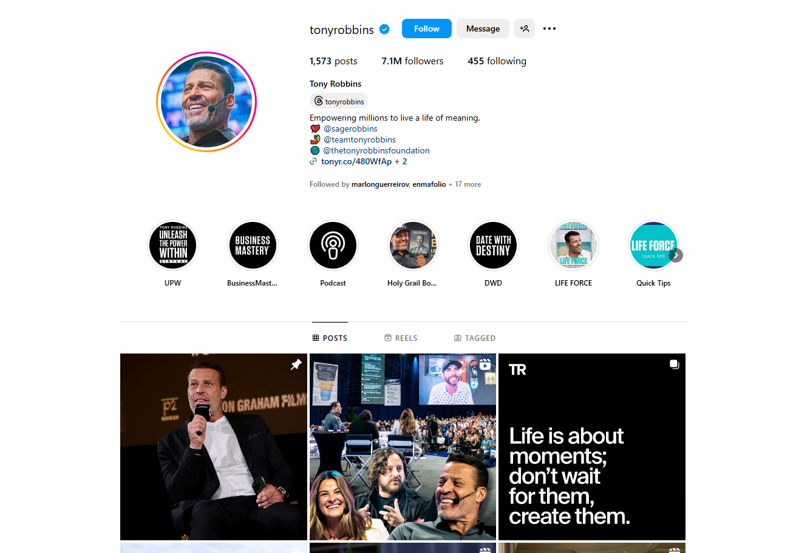
Instagram
Share infographics, photos, and short videos
Use Stories and Reels for quick tips and news updates
Humanize your firm with behind-the-scenes content
For more information, email us: team@bambiz.net
9

Slide 11
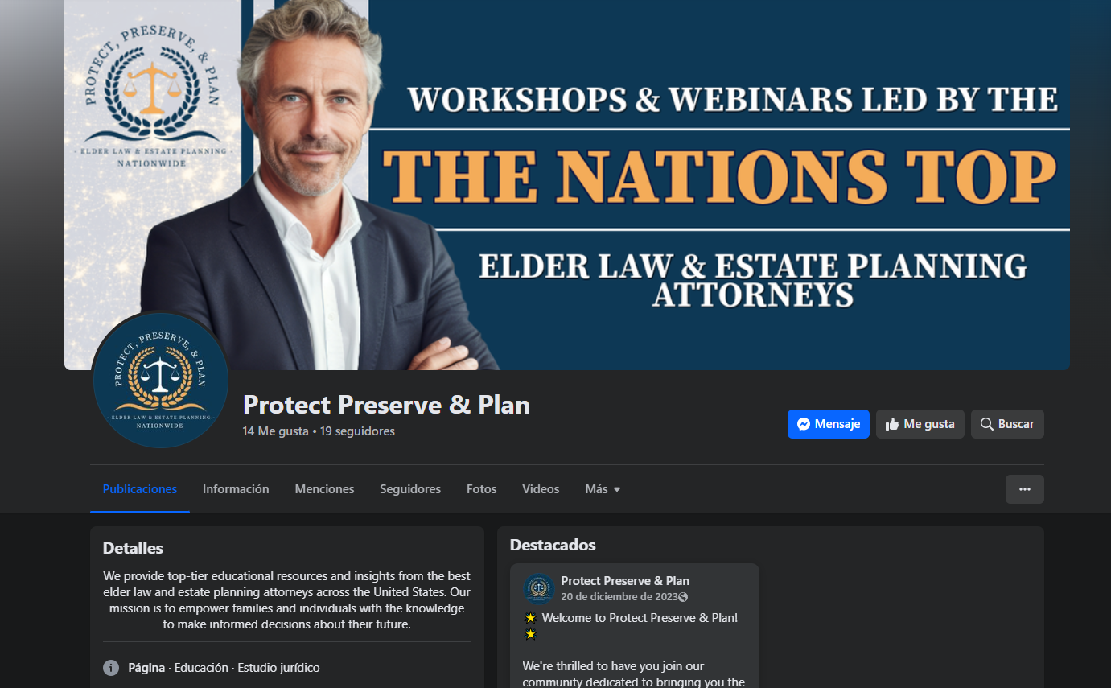
Facebook
Establish a business page
Share informative posts, articles, and updates
Engage with followers through comments, messages, and Facebook Live
For more information, email us: team@bambiz.net
10

Slide 12
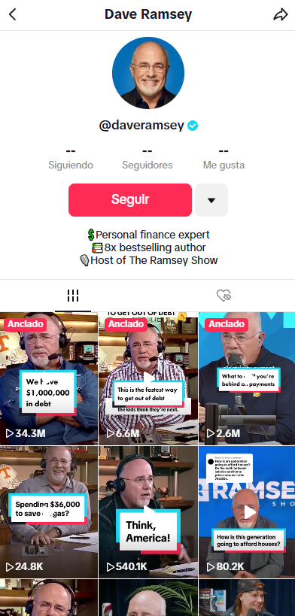
TikTok
Create short, engaging videos
Use popular trends and relevant hashtags
Cross-post to Instagram Reels and YouTube Shorts
For more information, email us: team@bambiz.net
11

Slide 13

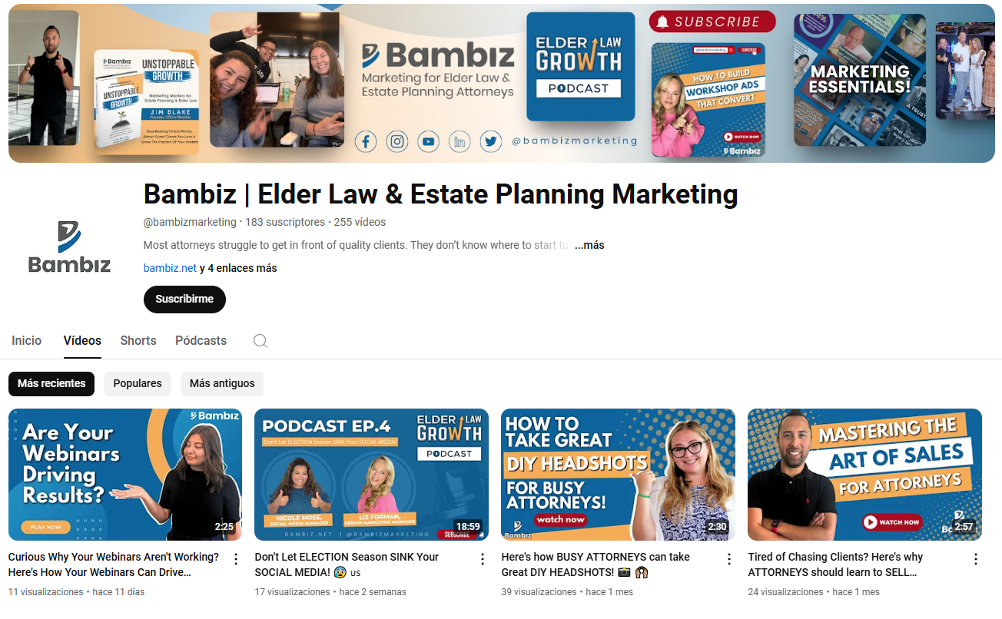
Leveraging YouTube
Showcase expertise with short, engaging videos
Avoid legal jargon; use clear language
Maintain high video quality
Use YouTube Shorts for quick tips and updates
For more information, email us: team@bambiz.net
12

Slide 14

Creating FAQ Videos
Address common client questions
Organize videos into playlists by topic
Enhance accessibility and engagement
For more information, email us: team@bambiz.net
13

Slide 15

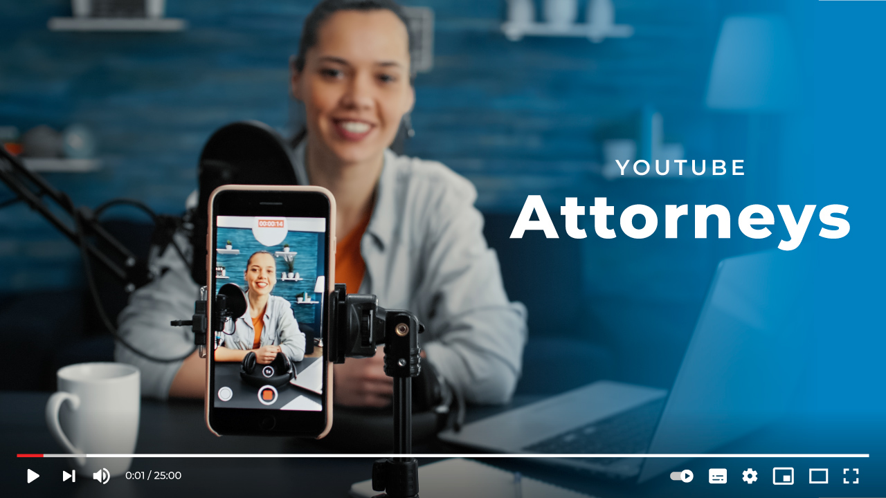
Learn from Successful YouTube Attorneys
Analyze their content and optimization techniques
Study audience engagement and branding
Apply successful strategies to your own content
For more information, email us: team@bambiz.net
14

Slide 16
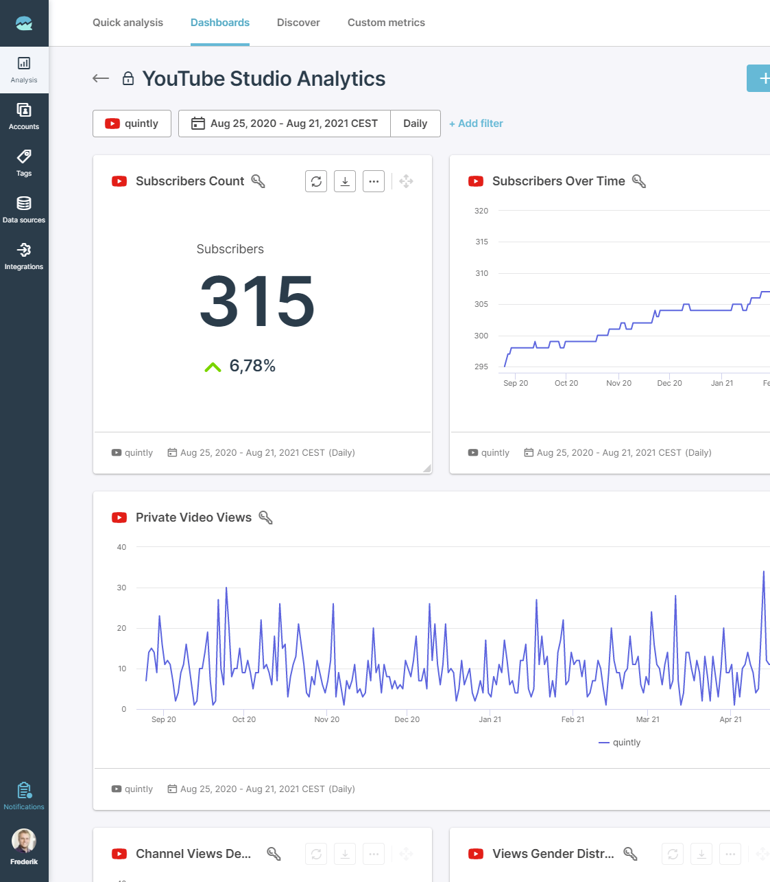

Track Key Metrics
Follower growth
Engagement rates
Click-through rates
Conversion rates
Regularly analyze data
For more information, email us: team@bambiz.net
15

Slide 17

Collaborate with Industry Peers
Collaborate with local influencers or professionals in related fields
Interview experts, co-host webinars, recommend each other's content
Expand reach and enhance credibility
For more information, email us: team@bambiz.net
16

Slide 18
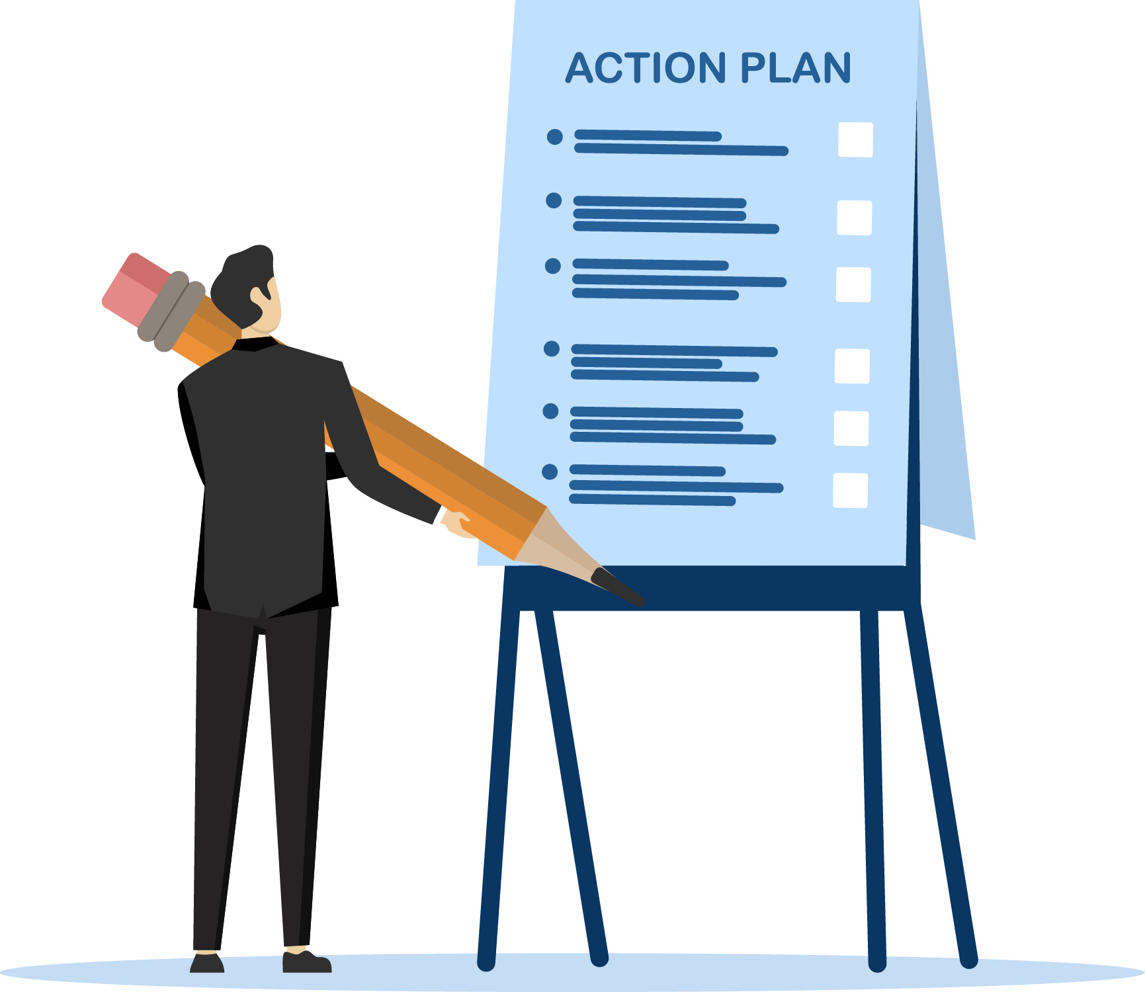
Time to Take Action
Set aside 2-3 hours a month to create social media posts
Use scheduling tools
Brainstorm hot topics for 3-5 minute videos
Block dedicated time for content creation
For more information, email us: team@bambiz.net
17

Slide 19
Building a Strong Online Presence
Consistency and adaptability are key
Leverage social media and YouTube to attract clients
Next video: Email Newsletter Marketing
For more information, email us: team@bambiz.net
18

