Slide 1





The Power of Online Reviews
For more information, email us: team@bambiz.net

Slide 2


The Power of Reviews
People check online reviews before choosing service providers, including legal services.
Positive reviews build trust, credibility, and attract new clients.
For more information, email us: team@bambiz.net
1

Slide 3
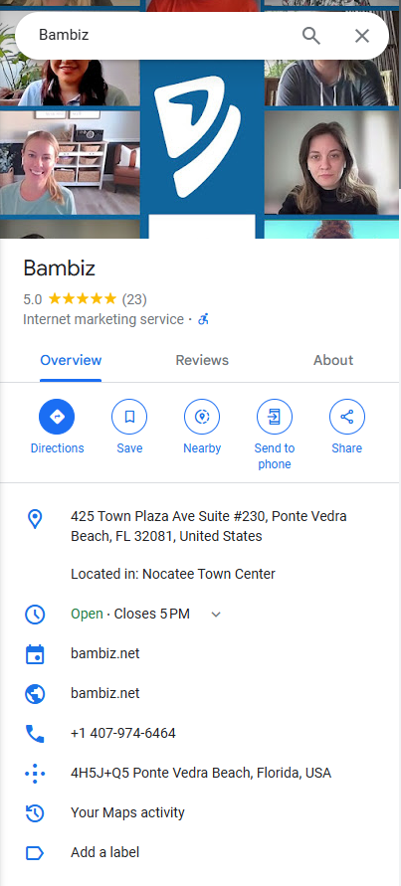
Building a Review Generation System
Create a system to generate positive reviews consistently.
Examples: Emails after consultations, workshops, or case closure.
For more information, email us: team@bambiz.net
2

Slide 4

Easy Review Process
Offer clear instructions
Utilize QR Codes
Direct Review Links
Consider Incentives (check state bar guidelines & platform rules).
For more information, email us: team@bambiz.net
3

Slide 5

Fostering a Review-Friendly Environment
Build Trust & Open Communication
Encourage your team to seek feedback actively and resolve issues promptly.
Satisfied clients = more positive reviews.
For more information, email us: team@bambiz.net
4

Slide 6


Setting Realistic Goals
Industry trends: 30-40% of clients asked will submit a review.
Calculate the number of review requests needed per month to reach your target.
Track progress and adjust your strategy
For more information, email us: team@bambiz.net
6

Slide 7

Automate Review Requests
Consider automated review request systems.
Examples: Triggers upon bill payment or case closure.
Tools: Birdeye, Podium, Bambiz Reputation Management System.
For more information, email us: team@bambiz.net
6

Slide 8


Leverage Google Business Profile Reviews
Google Business Profile is a goldmine for reviews!
Access your unique review link and share it
For more information, email us: team@bambiz.net
7

Slide 9

Respond to Reviews
Respond to all reviews, positive and negative.
Thank clients for positive feedback and acknowledge concerns in negative reviews.
Shows commitment to client satisfaction & strengthens relationships.
For more information, email us: team@bambiz.net
8

Slide 10

Analyze Competitors' Reviews
Keep an eye on competitors' online reviews and reputation management strategies.
Learn from what works and adapt those tactics.
For more information, email us: team@bambiz.net
9

Slide 11

Action Steps
Find your Google review link.
Research your competitors' online reviews.
Explore reputation management systems like Bambiz.
For more information, email us: team@bambiz.net
10

Slide 12

Coming Up Next…
Social Media Marketing Strategies for Elder Law & Estate Planning Firms.
For more information, email us: team@bambiz.net
12

