Slide 1





Understanding SEO for Elder Law & Estate Planning Firms
Boost Your Online Presence and Attract New Clients
For more information, email us: team@bambiz.net

Slide 2


Why SEO Matters
Attract new clients organically
Boost online presence
Make SEO understandable and actionable
For more information, email us: team@bambiz.net
1

Slide 3

Step 1: Understand Your Competition
Research keywords related to your services
Analyze top firms' content and structure
Identify effective strategies and areas for improvement
For more information, email us: team@bambiz.net
2

Slide 4

Step 2: Create High-Quality Content
Create original and informative content
Address target audience's concerns
Use clear language and avoid legal jargon
For more information, email us: team@bambiz.net
3

Slide 5

Step 3: Use Multimedia Content
Create YouTube videos, podcasts, infographics
Embed multimedia in articles for better SEO
Social media SEO: Optimize profiles, share content, use brand consistency
For more information, email us: team@bambiz.net
4

Slide 6

Step 4: Focus on Keywords
Use tools like Google Keyword Planner or Ahrefs
Target high-volume, low-competition keywords
Optimize content naturally
Track progress and adjust strategy with SEO tools, as needed
For more information, email us: team@bambiz.net
6

Slide 7

Step 5: Leverage AI Tools
The Assistant, NOT the Replacement
Generate content ideas and optimize text
Quality control is essential
Combine AI with personal expertise
For more information, email us: team@bambiz.net
6

Slide 8

Pro Tip: Strong Backlink Profile
Guest posting
Local citations and directories
Collaborations and partnerships
For more information, email us: team@bambiz.net
7

Slide 9
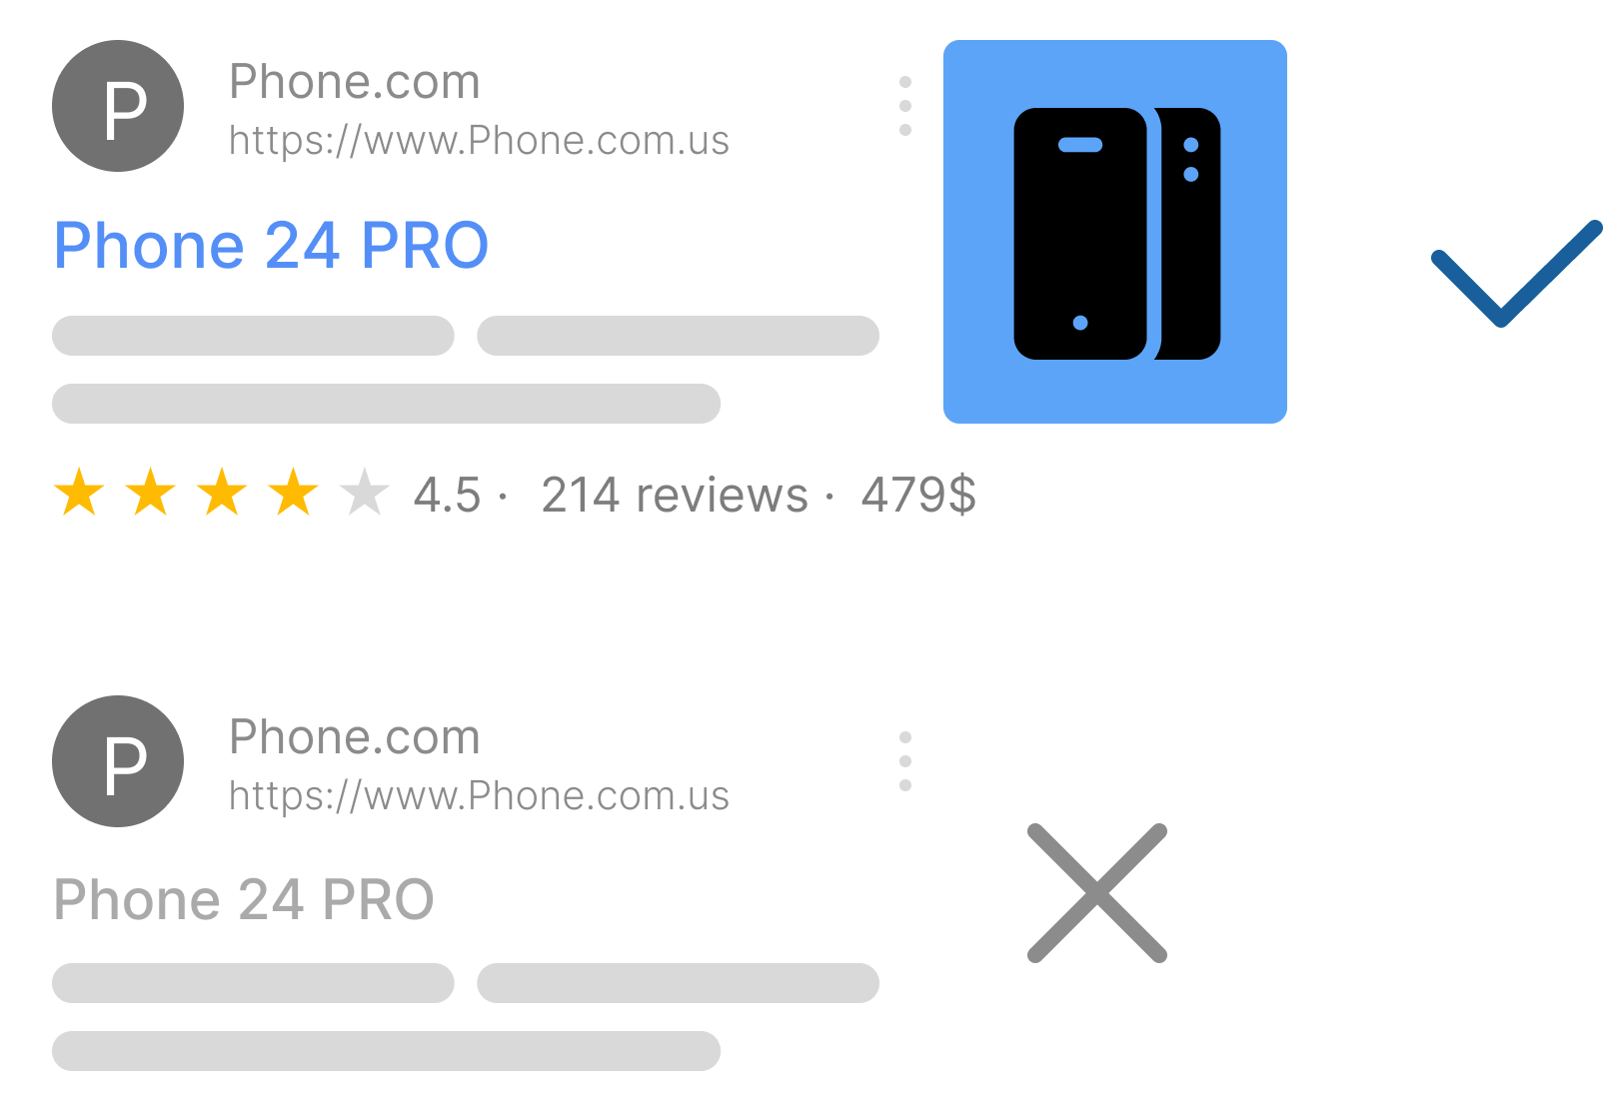
Pro Tip: Schema Markup
Enhances search result snippets
Use tools like Google’s Structured Data Markup Helper
Examples: contact info, client testimonials, CTAs
For more information, email us: team@bambiz.net
8

Slide 10
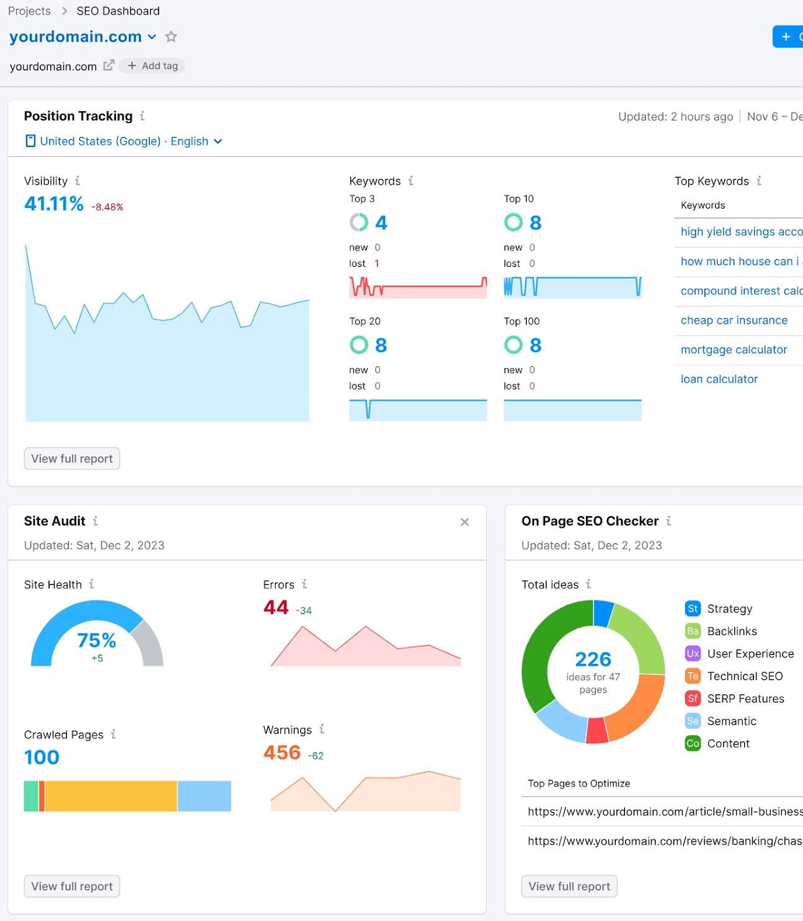
Pro Tip: Monitor Performance
Regularly monitor website performance
  Example tools: Google Analytics / Google Search Console
Track organic traffic, bounce rate, and conversion rate
Set goals and benchmarks
Stay Informed
For more information, email us: team@bambiz.net
9

Slide 11

Action Steps
Create an SEO strategy with specific goals
Understand your ideal client and their needs
Analyze top-performing content from competitors
Write unique, insightful content
Expand reach with multimedia and social media sharing
For more information, email us: team@bambiz.net
10

Slide 12
SEO: An Ongoing Process
Recap: SEO is Ongoing
SEO is a marathon, not a sprint
Stay adaptable and refine your approach
Next video topic: Online reputation management
For more information, email us: team@bambiz.net
12

