Slide 1





Creating an Effective Website for Elder Law & Estate Planning Firms
Attract Clients, Showcase Expertise, Convert Leads
For more information, email us: team@bambiz.net

Slide 2


Why Your Website Matters
Attract potential clients
Showcase expertise
Convert visitors into leads
For more information, email us: team@bambiz.net
1

Slide 3
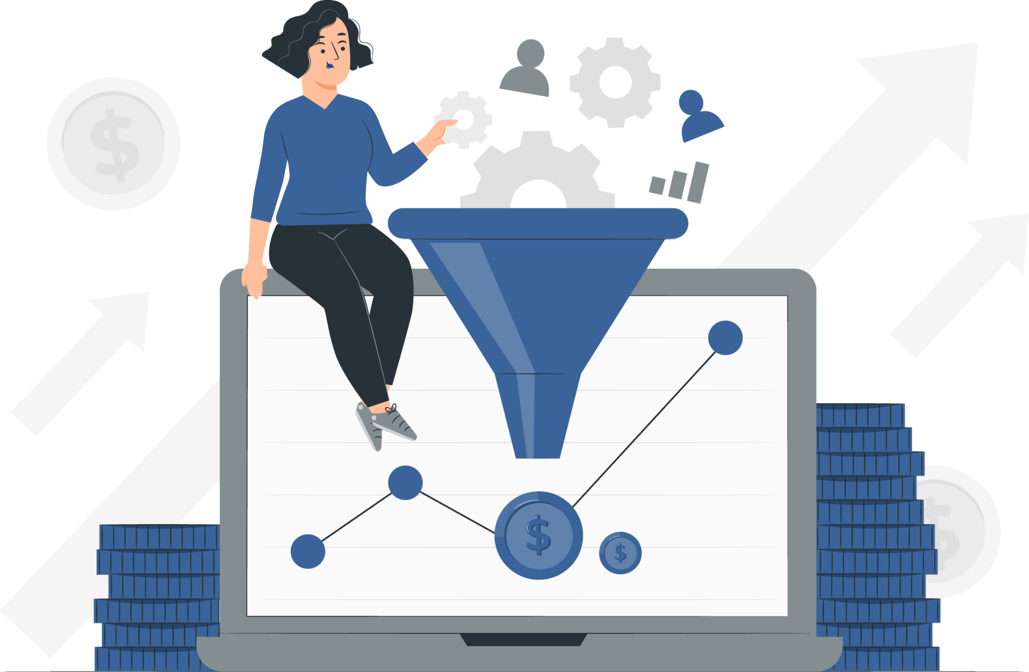
Website vs. Sales Funnel
Website: Online hub with information about services, team, and expertise
Sales Funnel: Targeted campaigns with specific calls to action (CTAs)
Website = foundation,
Funnel = targeted flow
For more information, email us: team@bambiz.net
2

Slide 4
Essential Website Elements
Call to Action (CTA)
Differentiating Statements
Client Problems
Personal Video
List of Services
Testimonials & Reviews
Simple Process
Firm Information
For more information, email us: team@bambiz.net
3

Slide 5

Prime Real Estate: “Above the Fold”
Clear Calls to Action (CTAs)
Statement of How You Help Clients
Differentiating Factors
For more information, email us: team@bambiz.net
4

Slide 6

Focus on the Client
Use client-centric language
Present firm as the trusted guide
Create compelling, client-focused content
For more information, email us: team@bambiz.net
5

Slide 7
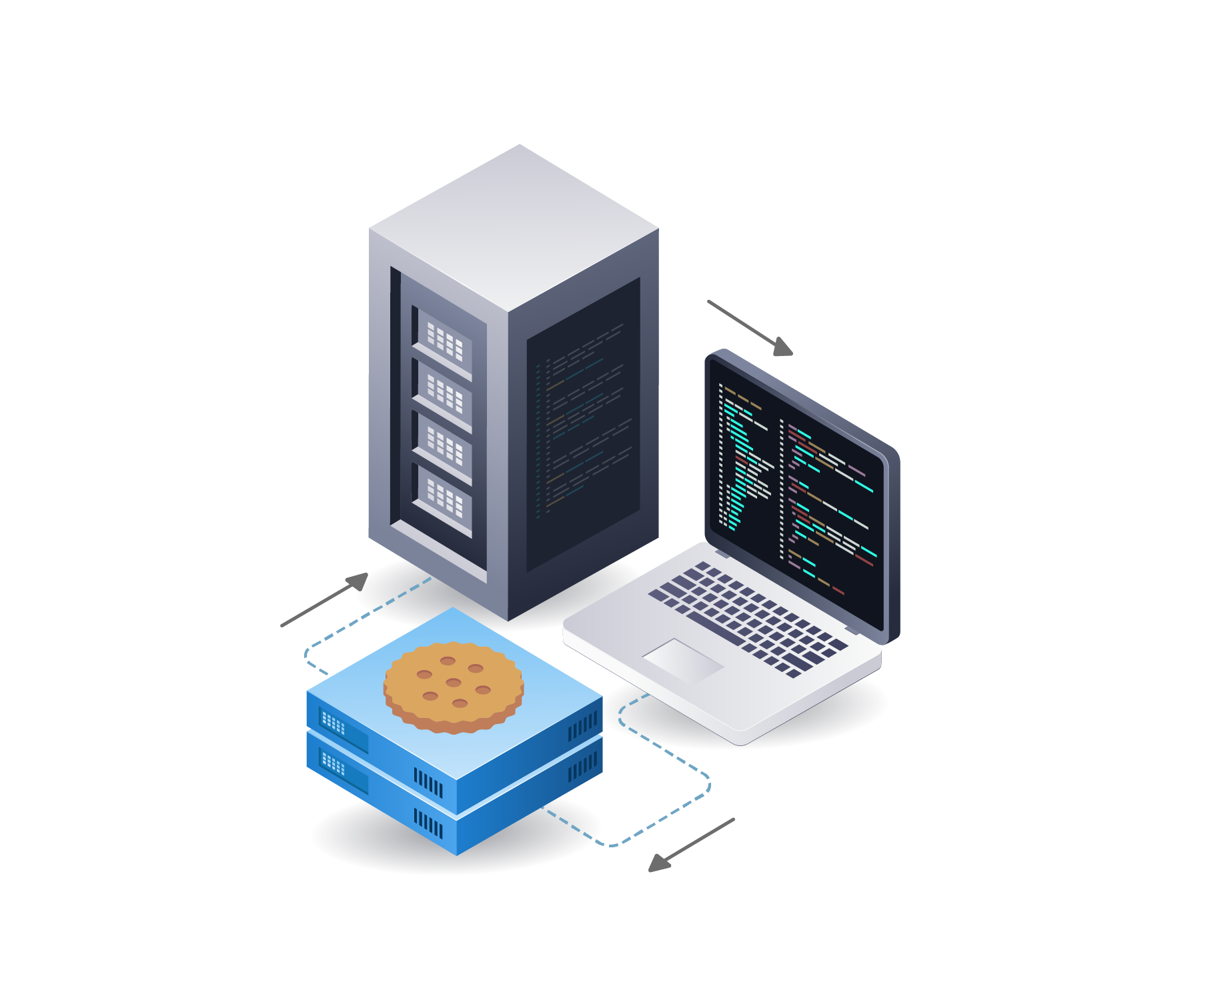
Understanding Website Cookies
Cookies: small text files that websites store on a user's browser to track their online activity and store information about them.
Compliance with data privacy regulations
For more information, email us: team@bambiz.net
6

Slide 8

Crafting a Compelling Narrative
Recommendation: "Building a StoryBrand" by Donald Miller
Framework: Address client needs, position firm as a solution, drive action
For more information, email us: team@bambiz.net
7

Slide 9

SEO: Getting Found Online
Potential clients need to find your website organically (search engines).
There are two main SEO strategies:
On-Page SEO: Optimizing website elements for search engines.
Off-Page SEO: External factors influencing website ranking.
Start SEO early and maintain ongoing efforts
For more information, email us: team@bambiz.net
8

Slide 10
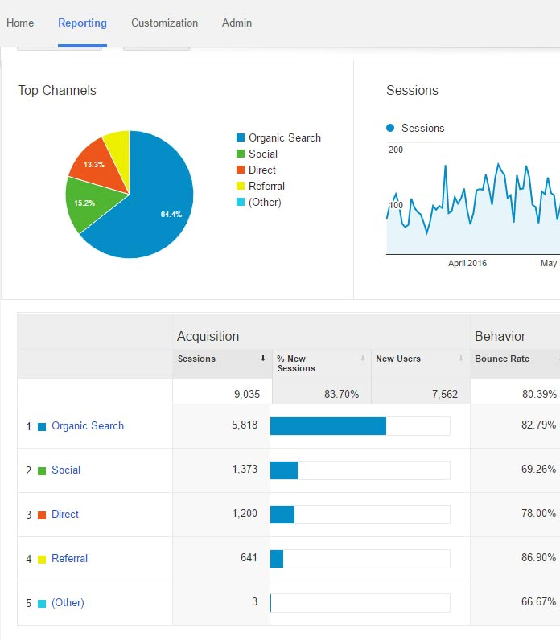
Monitor and Improve
Importance of tracking performance
Tools: Google Analytics
Making data-driven decisions
For more information, email us: team@bambiz.net
9

Slide 11
Let’s Recap
Recap: Design, client focus, content, narrative, SEO
Continuous improvement
Next video topic: Content marketing and social media
For more information, email us: team@bambiz.net
10

