Slide 1





Mastering Paid Advertising for Elder Law & Estate Planning
Jim Blake, Founder and CEO of Bambiz
For more information, email us: team@bambiz.net

Slide 2


The Importance of Paid Ads
Organic traffic takes time to build.
Paid advertising gets your firm in front of potential clients who need you right now.
Reach a wider audience and generate high-intent leads.
For more information, email us: team@bambiz.net
1

Slide 3

Golden Rules for Effective Ads
Be authentic
Experiment
Speak to their concerns
Be clear
Learn from the competition
For more information, email us: team@bambiz.net
2

Slide 4
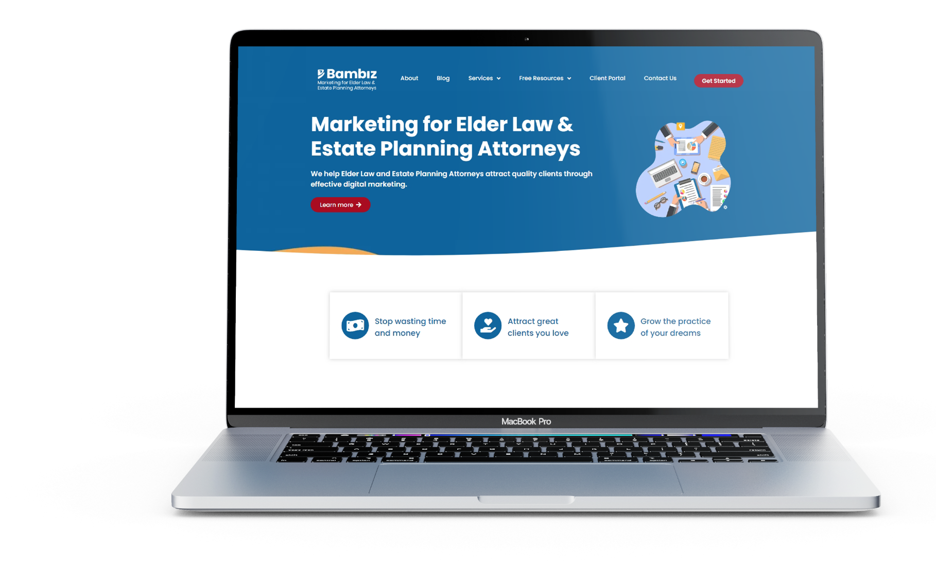
Optimizing Your Landing Pages
Keep it Simple
Mobile-friendly
Showcase the benefits
Social proof matters
Test and optimize
For more information, email us: team@bambiz.net
3

Slide 5

Monitoring Your Ad Performance
Track: CTR, conversion rates, ROAS, CPL.
Aim for the lowest CPL possible in your local market.
Regularly analyze and adjust your strategy.
Additional strategies to consider: Retargeting, Ad scheduling, A/B testing, Education.
For more information, email us: team@bambiz.net
4

Slide 6
When to Use Paid Ads
Build brand awareness for your new firm.
Expand into new markets or practice areas.
Increase lead generation for consistent growth.
Compete effectively with larger firms.
Improve website traffic and conversions.
Enhance your online presence across platforms.
Capitalize on seasonal opportunities (e.g., end-of-year planning).
For more information, email us: team@bambiz.net
5

Slide 7

Choosing the Right Platforms
Facebook: For highly targeted demographics, interests, and behaviors
Instagram: For younger audiences with visuals
TikTok: For future brand awareness
Google: For targeting users searching for specific keywords
LinkedIn: For reaching professionals and high-income individuals
YouTube: For education and engaging potential clients.
For Multi-platform success, remember this: consistency, tailoring, and experiment
For more information, email us: team@bambiz.net
6

Slide 8

Action Steps
Choose two platforms to advertise on.
Check out competitors' ads on the Meta Ads Library.
Create a PDF guide or video addressing common client questions.
Build a simple landing page.
Launch your ad campaign and connect it to an automation service.
Create a follow-up campaign and track your metrics.
For more information, email us: team@bambiz.net
7

